Slide 1
Project Title: Wisconsin Opioid Overdose Response Center and Pharmacy Resource Network
Granting Agency: Substance Abuse and Mental Health Services Administration
Wisconsin Association of Treatment Court Professionals 2024 Coordinator/Case Manager Conference
Oct 24th, 2024

Slide 2
Background and Problem
In 2022, fentanyl represented about 92% of opioid-related deaths and around 73% of all drug-related deaths in Wisconsin.
Between 2019 and 2022, rates of fentanyl overdose deaths doubled.
Department of Health Services issued a Public Health Advisory about fentanyl in August of 2022

Slide 3
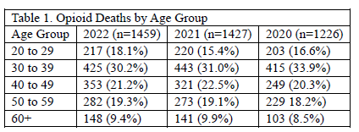
Background and Problem
Since 2000, 13,372 Wisconsinites have died from an opioid overdose.
30.8% of those deaths occurred from 2020 to 2022 (n=4,112) which is 61.3% of the total deaths that occurred in the prior decade.

Slide 4
Background and Problem
From 2014-2020 overdose deaths increased 263% among those released from prison, and 127% among those admitted to probation.
Deaths due to opioid overdoses have increased by 65% among veterans in recent years.
From 2018 – 2022, there has been a 3.3-fold increase in fentanyl overdose deaths among Blacks (68 vs 292); a 3.1-fold increase for American Indian/Alaska Native (16 versus 66); and a 1.3-fold increase for Whites (414 versus 941).

Slide 5
Our Mission
Support a sustainable community pharmacy network that deploys evidence-based interventions to reduce the number of opioid overdoses in Wisconsin

Slide 6
Our Vision
Healthier, happier communities that are empowered to work with pharmacy partners to deliver local solutions to their most pressing and sensitive healthcare challenges

Slide 7
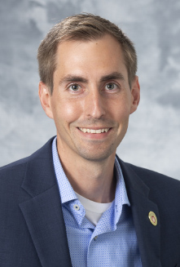
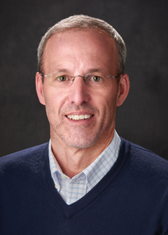
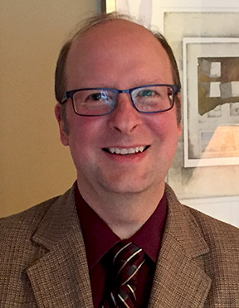
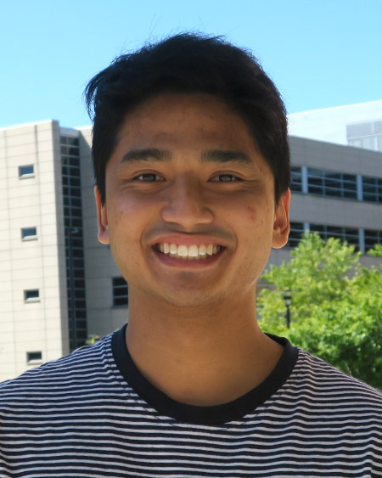
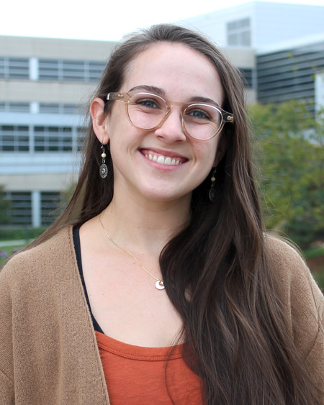
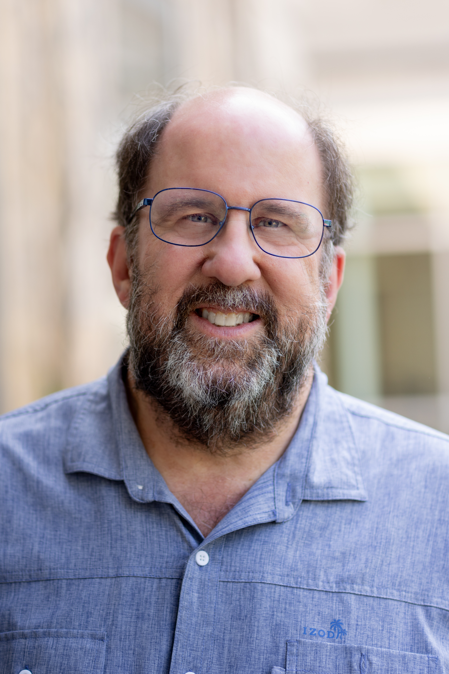
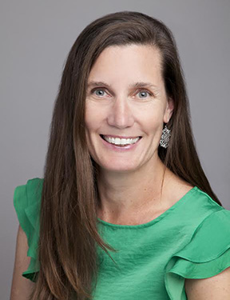
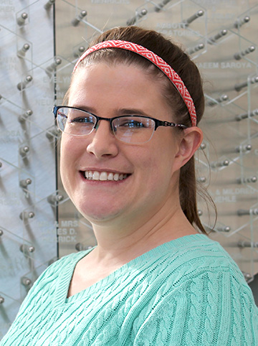
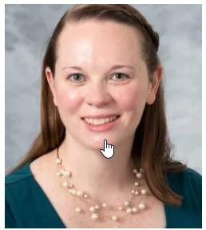
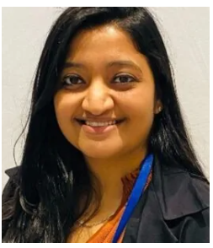
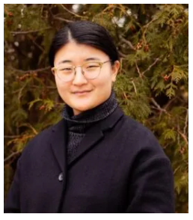
Our Team
Cody Wenthur
Dave Mott
Aaron Gilson
Uriel Matthew Enriquez
Sara Hernandez
Sally Griffith-Oh
Jay Ford
Michele Gassman
Brielle Wenthur
Jillian Kyzer
Riya Bhavsar
Suhjung Janet Lee
New Hires Not Pictured:
Amanda Dailey, Jax Smith, and Noah Klosowski

Slide 8
Our Partners
Rural Wisconsin
Health Cooperative
Pharmacy Practice Enhancement and Action Research Link

Slide 9
Our
Future

Slide 10
Goal #1
Establish a pharmacy-focused center at UW-Madison that is capable of developing, implementing, and communicating successful strategies to combat the opioid and fentanyl crisis in Wisconsin.
Objective 1.1 – Center co-directors will establish an advisory board consisting of at least five external subject-matter experts on opioid misuse and overdosing by Jan 1st, 2025.
Objective 1.2 – UW-Madison School of Pharmacy information technology and communications staff will establish a public-facing website and opioid overdose solutions clearinghouse by March 1st, 2025.
Objective 1.3 – Center co-directors will hire and train a central pharmacy network coordinator and three pharmacy solution implementation specialists by Jan 1st, 2025.

Slide 11
Goal #2
Increase patient access to evidence-based treatments for opioid use disorder and opioid overdose through expansion of community pharmacy-based services in Wisconsin.
Objective 2.1 – Pharmacy solution implementation specialists will have enabled five new community pharmacy sites in each of the five Department of Health Services regions in Wisconsin to provide abuse and diversion tools such as fentanyl test strips, mail back envelopes, or disposal pouches to their patients and customers by June 1st, 2025.
Objective 2.2 – Pharmacy solution implementation specialists will have coordinated pharmacist-initiated, phone-based naloxone outreach and dispensing in five veteran-facing or low-income outpatient clinics in Wisconsin by Sept 1st, 2025.
Objective 2.3 – Pharmacy solution implementation specialists will have enabled new community pharmacy sites to provide long-acting injectable medications for opioid use disorder in two currently unserved Wisconsin areas of concern with high rates of opioid overdose as defined by the Department of Health Services by Sept 1st, 2025.

Slide 12
Goal #3
Increase the capacity of pharmacies and pharmacists in Wisconsin to access and deploy evidence-based educational materials and programs focused on opioid misuse and overdose risk mitigation strategies.
Objective 3.1 – Pharmacy solution implementation specialists will have overseen distribution of patient-validated naloxone educational pamphlets to fifty new community pharmacies in Wisconsin by March 1st, 2025.
Objective 3.2 – The center’s pharmacy network coordinator will have recruited ten new community pharmacists to provide prescriber education on expanded buprenorphine access regulations by Sept 1st, 2025.
Objective 3.3 – The center’s pharmacy network coordinator will have enrolled twenty new community pharmacists in Wisconsin Pharmacy Examining Board-approved coursework on administration of long-acting injectable medications by June 1st, 2025.

Slide 13
Goal #4
Develop new technologies suitable for use by Wisconsin pharmacists and pharmacies to prevent overdose from existing and emerging synthetic opioid molecules.
Objective 4.1 – Pharmacy solution implementation specialists will have collected complete anti-opioid vaccine logistical and ethical barrier surveys from fifty new community pharmacy sites in Wisconsin by June 1st, 2025.
Objective 4.2 – UW-Madison School of Pharmacy Scientists will have developed antibodies capable of recognizing three structurally distinct synthetic opioid classes in biological matrices by June 1st, 2025.
Objective 4.3 – UW-Madison School of Pharmacy Scientists will have assessed two anti-opioid vaccine formulations for modification of drug reward and overdose risks in preclinical models by Sept 1st, 2025.

Slide 14
We are interested in helping incorporate pharmacists into your workflow.
Please stop by the vendor booth or the ask the expert round table from 3 to 4 to share your thoughts and ideas about how this might work.
Follow-up with us

Slide 15
Questions / Comments

