Slide 1
Toxicology Drug Testing and trends
Sara J. Schreiber, PhD, D-abft
WATCP - October 2024

Slide 2
A quick get to know ya

Slide 3
Matrices for screening
Blood
Urine
Oral Fluid
Hair

Slide 4
Drug detection times
Breath < Blood ~ Oral Fluid < Urine < sweat < hair

Slide 5
Benefits and drawbacks of blood
Actively circulating
Current snapshot
Most data for this matrix
Not easily adulterated
Skilled collection
Invasive collection

Slide 6
Benefits and drawbacks of urine
Provides Historical information
Metabolite heavy
Uninterpretable concentrations
Specimen collection issues
Adulteration issues

Slide 7
Oral Fluid Drug Testing

Slide 8
Oral fluid
Oral fluid
Water, Electrolytes, immunoglobins, Enzymes, Proteins
Normal ph: 5.5-7.9, Normal flow is variable
PH and flow rate is variable based on
Circadian rhythms, physical activity and health
Stimulation can have effects on PH, flow rate, affecting ion trapping

Slide 10
Oral fluid testing
Advantages
Less invasive, observed collection
Training important but clinical expertise not required
Difficult to adulterate
Gender neutral specimen collection
Basic drugs concentrate in lower Ph of oral fluid
Oral or inhaled drugs coat the oral mucosa

Slide 11
Oral fluid testing
Limitations
Specimen volume
Drug absorption to the collection device
Elution buffer critically important
Drug recovery
Drug stabilization
Dilutes the OF
May interfere with analytical techniques

Slide 12
Drugs in OF
mechanisms affected by:
Molecular size
% protein bound in blood
Lipophilicity of drug
Non-polar analytes partition into OF more readily than polar metabolites – higher parent drug concentrations
Pka of drug
Non-ionized basic drugs in blood partition into more acidic OF – ion trapping of basic drugs
Passive diffusion of free unchanged drug, ultrafiltration (alcohol), active secretion & coating of oral mucosa from smoked, inhaled, insufflated drugs

Slide 13
Factors affecting drugs in OF
Physiochemical characteristics
Route of drug administration
Biological matrix attributes (PH)
Drug dose
Physiological factors
Analytical method capabilities
Time factors
Specimen collection
Drug and metabolite stability
Individual variability

Slide 14
Hair Drug Testing

Slide 15
Introduction
Drugs circulating in the blood get incorporated into the hair cells
Drugs are then trapped when the hair is keratinized
The trapped drug then moves out on the hair as it grows
In theory, this creates a calendar of previous drug use
In reality, it is more complicated
Drugs can be deposited from sweat, and secretions as well as external sources (powders, smoke)

Slide 16
Hair analysis
Analysis is straightforward
Interpretation the challenge
SoHT – Society of Hair Testing – 1995

Slide 17
Applications
Drug –related deaths
Drug-facilitated crimes
Child protection cases
Drug use monitoring
Workplace
Rehabilitation
Driver’s license reinstatement

Slide 18
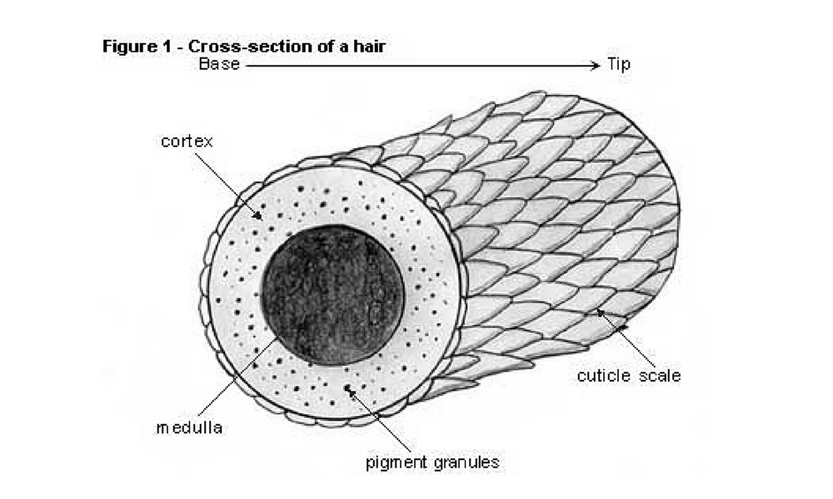
Hair physiology
Composed of proteins (65-95%), lipids (1-9%) pigments (0.1-5%)
Minor amounts of trace elements, polysaccharides and water
Cuticle – a sheath of overlapping scale cells
Cortex – the bulk of the hair fiber
Spindle shaped keratin-containing cells
Medulla – center of the cortex
Can be continuous or fragmented
Hair is formed in the follicle 3-5mm
beneath the epidermis

Slide 19
Hair Physiology
During formation melanin pigments are introduced into the hair
Melanin is only a few percent of the hair matrix
Attract and bind chemicals
Growth rate is a factor for interpretation and incorporation

Slide 20
Drug Disposition into the Hair
Active or passive diffusion from the blood vessels in the dermal papilla
Diffusion from sweat and other secretions bathing the growing or mature hair
External drugs from vapor or solid that diffuse into the mature hair

Slide 21
Systematic Incorporation from the Blood
Rapid cell division requires good blood supply to the hair follicle and results in the ready delivery of circulating drug molecules to the growing hair.
For drugs to enter the matrix they need to diffuse across the cell membrane
Rate is dependent on the lipid solubility of the drug, pH between the blood and cell
Once in the cell cytosol, the molecule will be protonated and not able to diffuse back to the blood

Slide 22
Incorporation from Sweat and Other Secretions
Administered drugs or metabolites will excrete in sweat or sebum and therefore are potential routes for drug incorporation into the hair.
Drugs like codeine and cocaine can be detected in hair shortly after administration, suggesting deposition on the already mature hair.
Deposition from sweat come from consumed drugs
Problematic if comes from someone else’s sweat

Slide 23
Incorporation from External Contamination
Exposure of hair to environment, external contamination should be considered an alternative explanation for a positive result.
Some drugs can be removed by washing and others not.

Slide 25
Drug Analysis
Segmentation
Washing
Homogeneity and sample amount
Extraction

Slide 26
Benefits and drawbacks of hair
Historical
Analysis
Orientation
identify the root
Not current snapshot

Slide 27
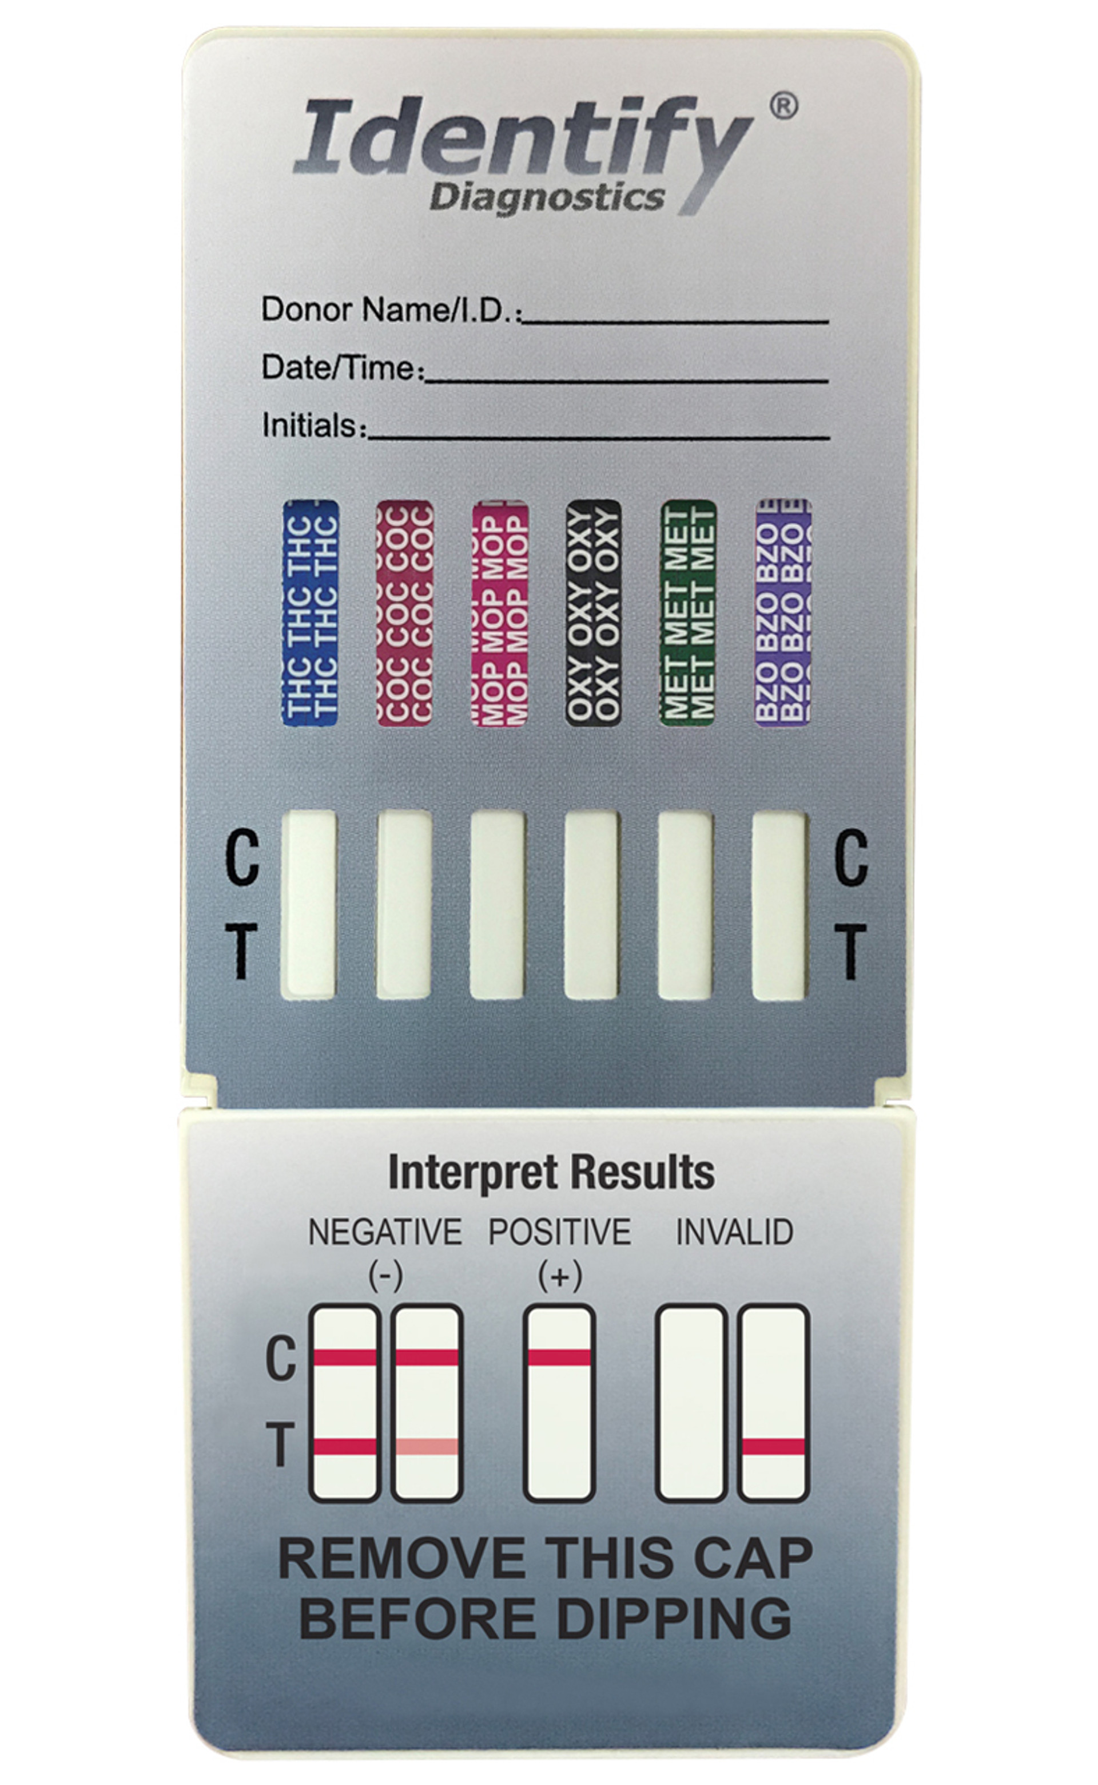
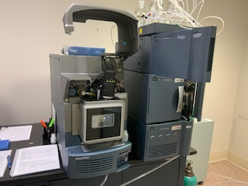
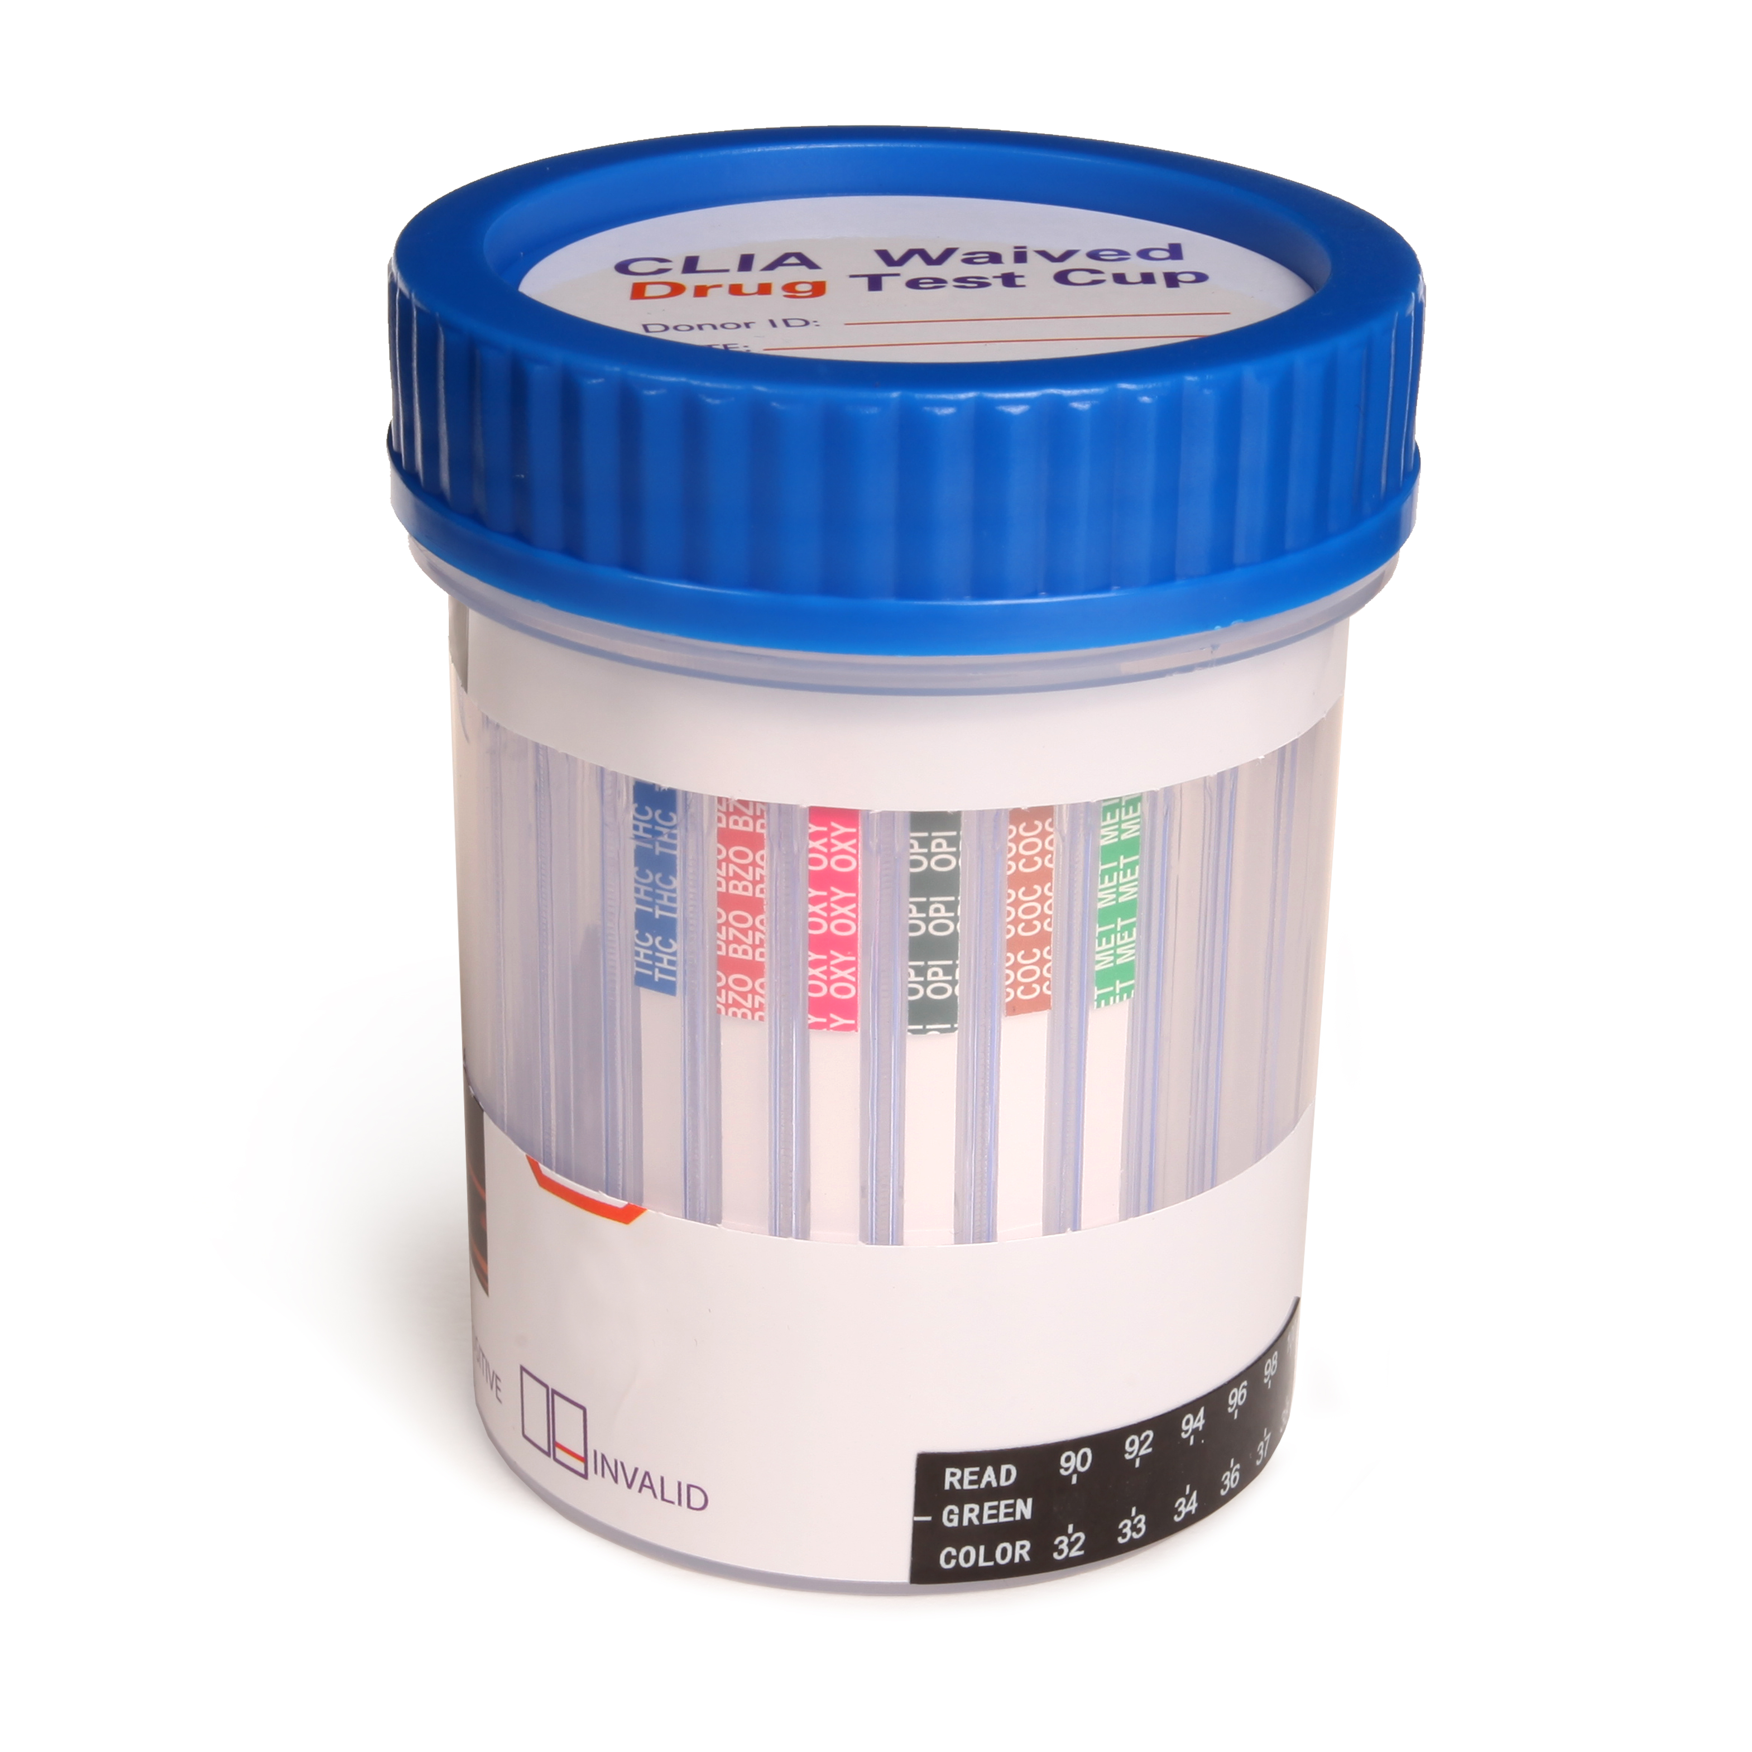
testing types
screening
Confirmatory
Multi-drug screen test cup
Cassette
Dip Card
Drug strips
Chromatographic analysis
Spectral identifications

Slide 28
Drug testing

Slide 29
Screening test
6-monoacetylmorphine
Amphetamine
Barbiturates
Buprenorphine
Benzodiazepines
Clonazepam
Cocaine
Cotinine
Methadone metabolite
Ethyglucuronide
Norfentanyl
Synthetic marijuana
AB-PINACA
Mitragynine
Ecstacy
Methamphetamine
Methadone
Morphine
Opiates
Oxycodone
Phencyclidine
Tricyclic antidepressants
Marijuana
Tramadol

Slide 30
Drug testing
More than one test
Screening or preliminary testing
Confirmatory testing
Understand the scope and limitations of the testing choice

Slide 31
Testing limitations
What does it detect well
What does it not detect well
Studies done under optimal conditions
Did not evaluate for drug-drug interactions

Slide 32
6-monoacetylmorphine
Why important?
Detect well:
6AM
Does not detect well:
Morphine, heroin, codeine, oxycodone, oxymorphone

Slide 33
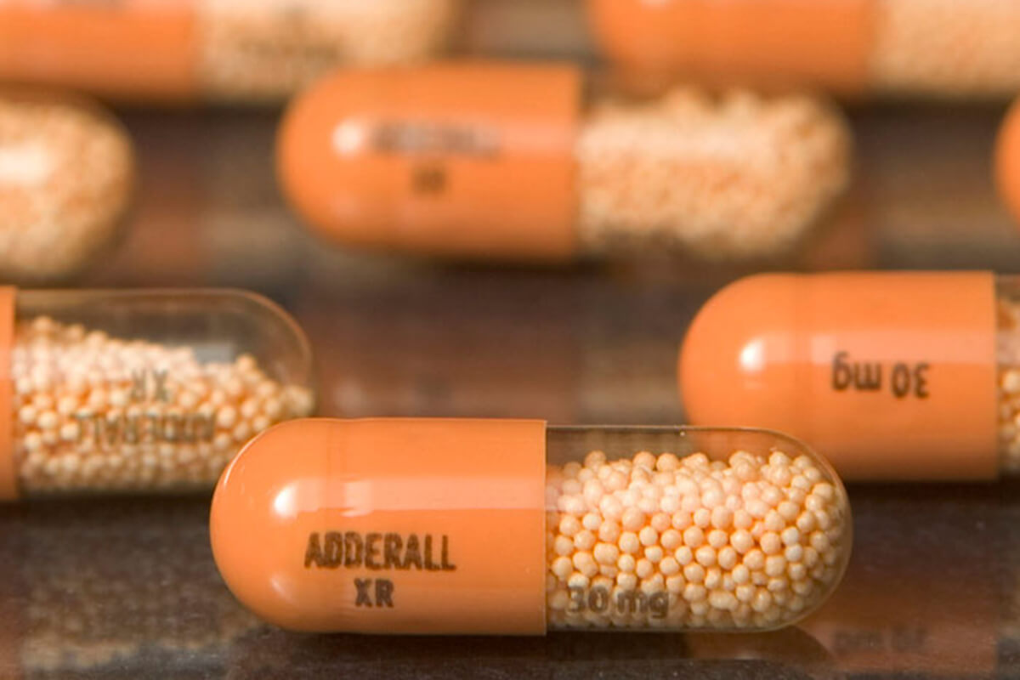
amphetamine
Why important?
Detect well:
amphetamine
Does not detect well:
MDA, phentermine, methamphetamine

Slide 34
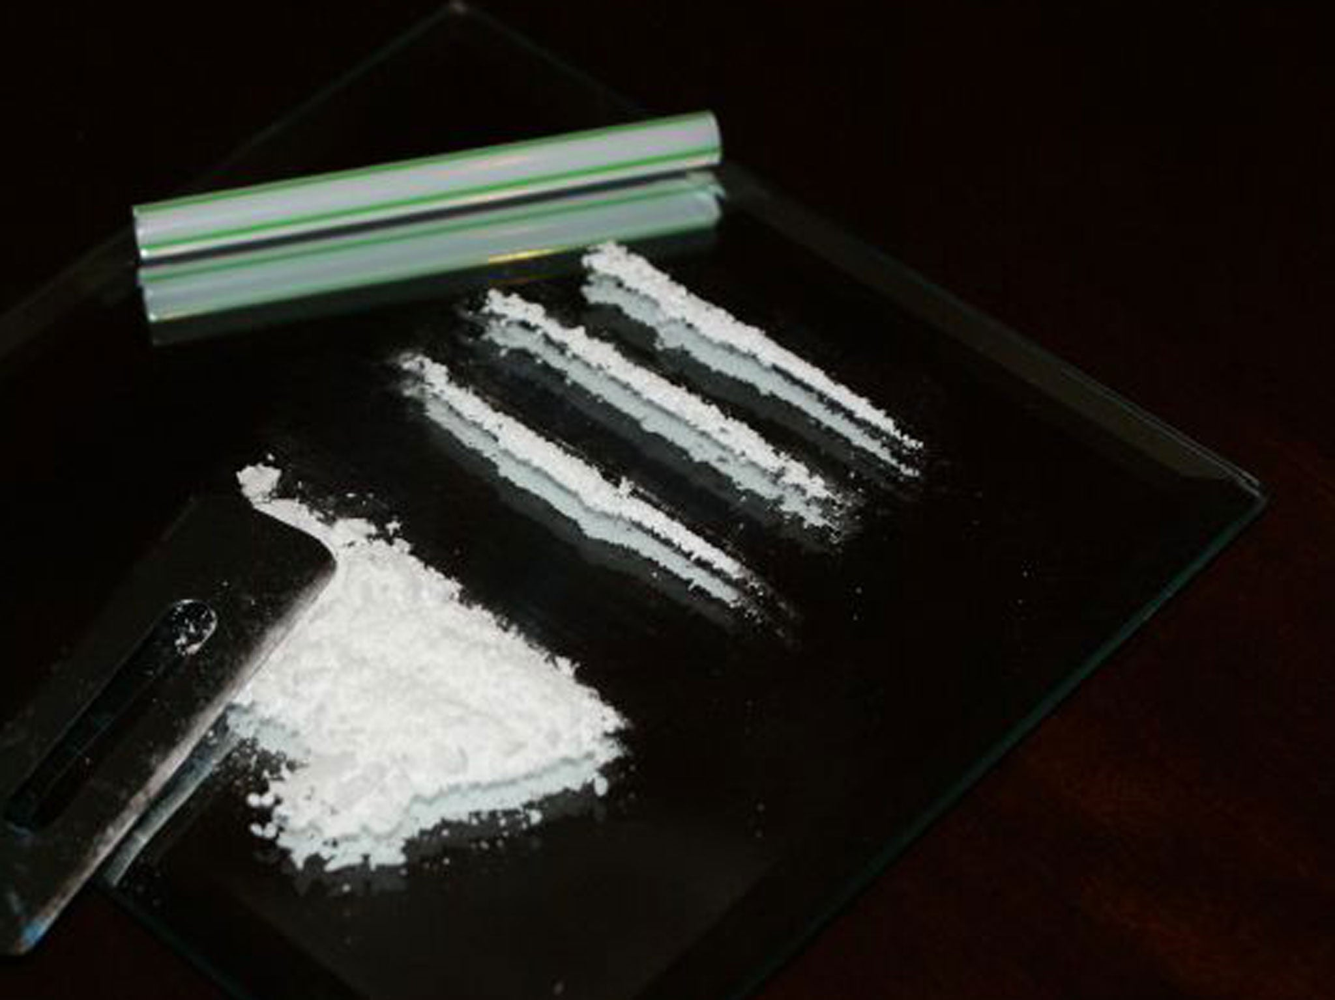
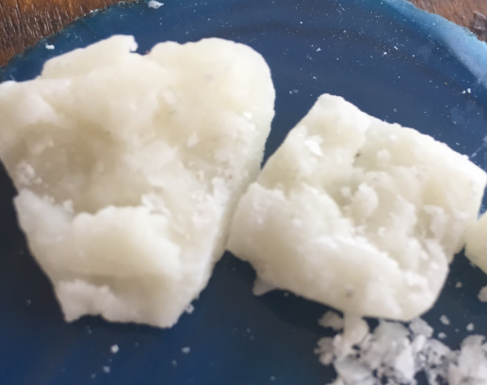
Cocaine
Why important?
Does not detect well:
Cocaine
Cocaethylene
Ecgonine
Does detect well:
Benzoylecgonine

Slide 35
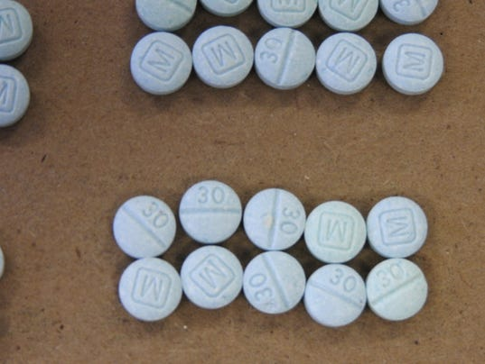
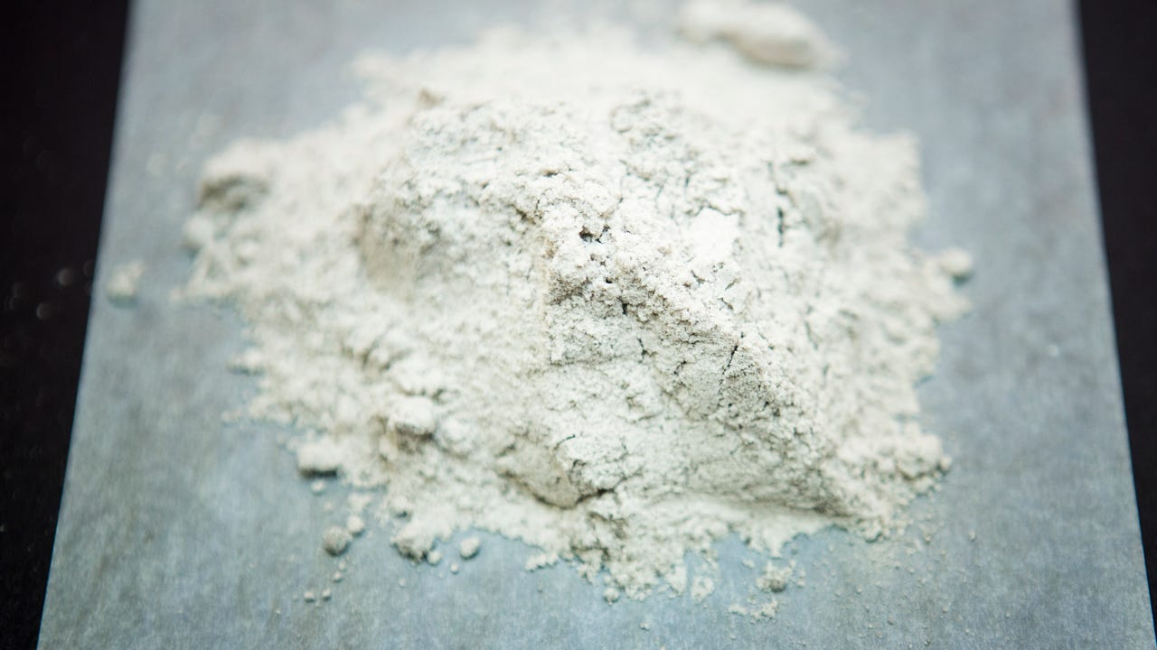
Fentanyl
Why important?
Does detect well:
Norfentanyl
Does not detect well:
Fentanyl
No mention of fentanyl analogs

Slide 36
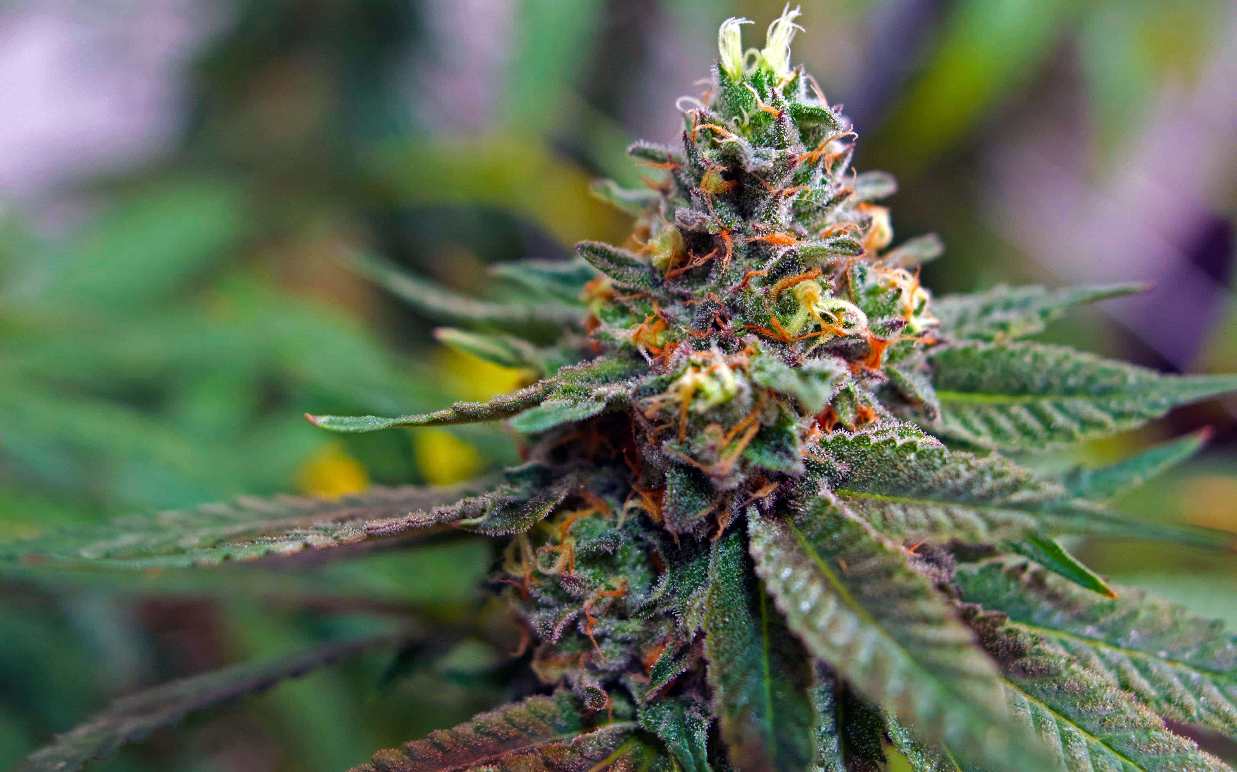
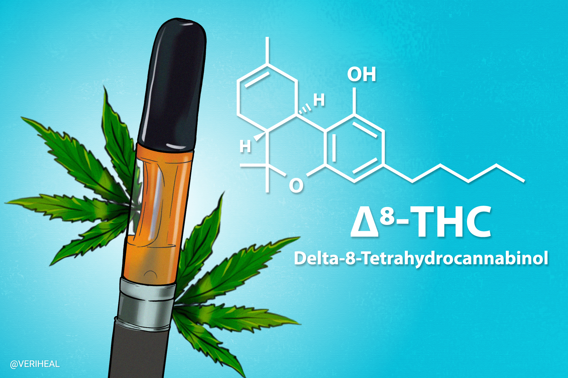
THC
Why important?
Does detect well:
11-nor-9-carboxy THC
Does not detect well:
Delta-9-THC
Delta-8-THC
Cannabidiol
Cannabinol
11-OH THC

Slide 37
What’s missing?
Unknown unknowns

Slide 38
Analytical instrumentation
Liquid chromatography – mass spectrometry
Gas chromatography – mass spectrometry
Liquid chromatography – quadrupole-time of flight
Separation of the mixture, isolation of the analyte for identification
Be mindful of the scope

Slide 39
NDEWS

Slide 41
Breaking news, or not…
Increasing conversation:
Tucibi, 2c-B, pink cocaine, C, 2C, tuci
Rarely contains 2C compounds
MDMA, ketamine, caffeine, “bath salts”, fentanyl, and/or other opioids
Rave-type settings
2-MMC, 2-Methylmethcathinone
substituted cathinone derivative
related to 3-methylmethcathinone and 4-methylmethcathinone (mephedrone).
stimulant and euphoric effects.

Slide 42
Kratom
Nitazenes, Isotonitazene, Brorphine, Metonitizine, Protonitizine, N-Pyrrolidino Protonitazene, N-Pyrrolidino Metonitazene
Increased potency compared to fentanyl
‘des’ compounds don’t react with testing strips
Mixed with other analytes
Avizafone
Prodrug for diazepam

Slide 43
Cyclorphine
a "benzimidazolone derivative
potent opioid effects
around 4 times stronger than fentanyl
Heavily sedating

Slide 44
Fentanyl
Fatalities decreasing
Present in 50% of heroin cases
Increasing prevalence in stimulants (Meth, coc)
Co-occurrence with others (prescription benzos, cannabinoids, hallucinogens, prescription stims)

Slide 46
Congratulations!
There are so many working to lower that number and you are to be commended

Slide 47
Answers to questions
Thank you!

