Slide 1
Research Says… Best Practices in Assessment, Management and Treatment of Impaired Drivers
Wisconsin Association of Treatment Court Professionals
Treatment Court Conference:
March 25, 2015

Slide 2
Mark Stodola
NHTSA Probation Fellow
American Probation and Parole Association
Notes:
My background including probation, Muni Court and Probation Fellow

Slide 3
Provide participants with information about evidence based assessments, management tools and technologies that can be used to enhance their effectiveness in the supervision of impaired drivers.
Notes:
Over the next 60 minutes I hope to……………

Slide 4
Learning Objectives
Identify how DWI assessments impact supervision strategies
Identify at least two supervision strategies that are effective in the supervision of DWI offenders
Explain how assessments can help deliver the most appropriate treatment dosage based on offender risk and needs

Slide 5
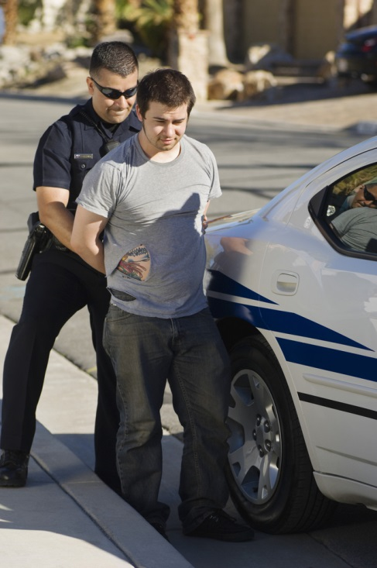
In 2011, there were 1.2 million drivers arrested for driving while under the influence
So, what’s the problem?
In 2013 there were 10,076 alcohol related traffic fatalities.
More than 30% of drivers involved in fatal crashes on weekends are alcohol-impaired.
Notes:
Since 1980, over 300,00 alcohol related fatalities. While traffic fatalities have gone down it remains steady that a third of traffic fatalities are due to alcohol impaired drivers

Slide 6
Wisconsin DWI Fatalities
Alcohol-Impaired Driving Fatalities (BAC=.08+)* | 2009 203 | 2010 202 | 2011 195 | 2012 209 | 2013 178
Notes:
2013 Alcohol fatalities in WI is 33% of total. 11% decrease over 2012. Why? National Average is 31%. Utah 17% and Mont./SC at 44%. IN 05 322 alc fatalities so significant improvement in CY 13 543 total fatalities

Slide 7
Other Wisconsin Statistics-2013
11.9% decrease in DWI fatalities
Alcohol related crash injuries-2,660
DWI Arrests-30,927
DWI Convictions- 26,081
Tax payer subsidy of fatalities- $890 million
3 time offenders- 46,539
5 time offenders-8,088

Slide 8
4,751,400 individuals under community supervision in 2013
15% of this probation population have been convicted of DWIs
8% of the probation population have been convicted of multiple DWIs
Notes:
drivers on Community Supervision –what are the numbers?
According to the Bureau of Justice Statistics, there were 4,751,400 individuals under community supervision in 2013
About 15% of this probation population have been convicted of DWIs
About 8% of the probation population have been convicted of multiple DWIs

Slide 9
Impaired drivers-Who are you most likely to supervise?
High risk drunk drivers:
BAC level of .15 or above
More than one drunk driving arrest
Highly resistant to changing their behavior
Less than five percent of these drivers account for about 80 percent of the impaired driving episodes
Notes:
According to the Traffic Injury Research Foundation (TIRF), Offenders with multiple DUI’s typically white males late 20’s to early 30’s, low education, more aggressive and hostile,, unmarried (though this is old information), multiple priors for both alcohol and non alcohol related offenses.

Slide 10
Responsible for 6 of 10 alcohol related deaths

Slide 11
Unique challenges to supervising these impaired drivers
Notes:
These offenders don’t identify as being “criminals”. Probation officers describe this population as the one who will id as being different than other populations Anti-social, more difficult to catch in violation. “How come everyone else can drink and I can’t? The other challenge for departments is how much time you give to this population. Departments are always faced with competing interests with caseloads rising and higher risk offenders being placed on probation

Slide 12
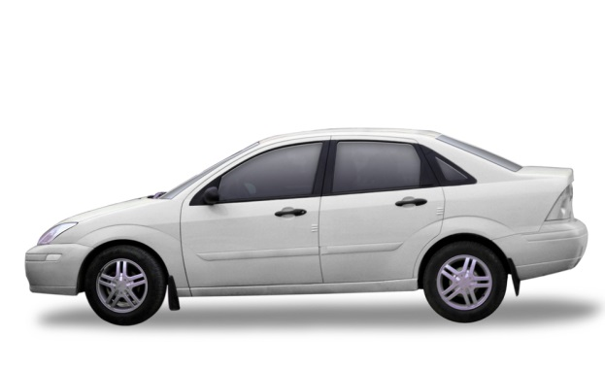
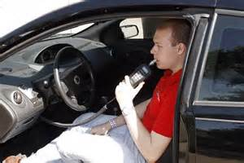
Three approaches to addressing behaviors of drunk drivers
Prevent Driving
Prevent Driving After Drinking
Prevent Drinking
Notes:
Most individuals (about 2/3) who receive a DWI self correct. Shame, cost of attorneys and fines loss of job (in az 24 hours in jail)and incarceration are enough to change behaviors. most individuals who receive a DUI self correct.. Prevent driving-1st offenders not in probation system-alcohol consumption not monitored.- DL revocation, jail
Drinking and driving-interlock- again, no admonition against drinking- IN these cases, more going on than addiction to alcohol, issue of decision making
Drinking-typically what APD’s are faced with.
1). Prevent driving-suspension of license, interlock, alcohol education, perhaps jail time- off the street- If they want to continue drinking, that’s their business as long as they get behind the wheel
2). Driving after drinking- Interlock, devices to indicate if impaired
3). Prevent drinking- This is the population probation departments have to deal with. Court has ordered a prohibition against alcohol consumption. This should be included on terms.- If not someone needs to talk with your judges… Addressing alcohol abuse- We are faced he potential scenario of probationer who never gets behind the wheel who could be violated for drinking For any of you frustrated APO’s out there, this is a tough nut to crack.

Slide 13
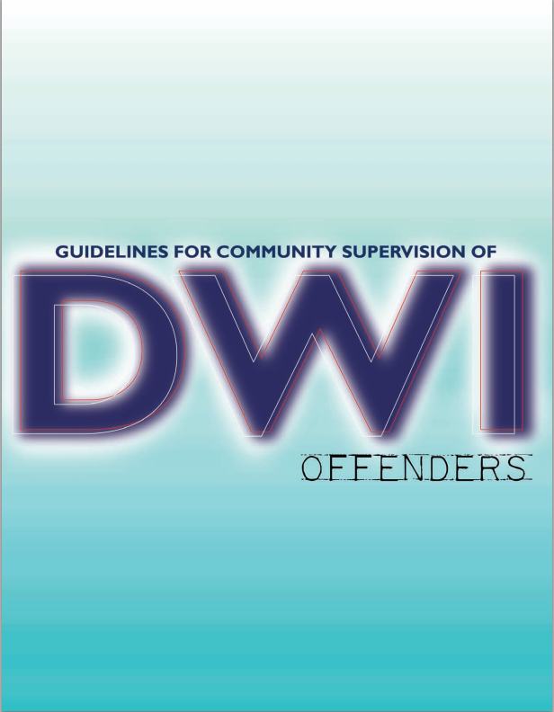
Notes:
Introduce the Guidelines – let participants know we will email them a PDF copy of the book after the webinar
This document is available for free on the APPA website. APPA Doc- Link included at end of presentation.

Slide 14
Guidelines for the Community Supervision of DWI Offenders
Guideline 1
Investigate, collect, and report relevant and timely information that will aid in determining appropriate interventions and treatment needs for DWI offenders during the release, sentencing, and/or supervision phases.
Notes:
Integral part of this guideline is assessment. I am going to turn this over to Nathan.

Slide 15
Assessing for Risk/Needs Among Impaired Drivers

Slide 16
Are abuse or addiction the only causal factors we should be concerned about?
Notes:
In order to best address this phenomenon, it is important for community corrections practitioners, like you, to understand the causal factors associated with chronic impaired driving. While abuse or addiction to alcohol or other drugs (AOD) are significant contributing factors, they alone do not fully explain this behavior. Risk screening for driving while impaired (DWI) supervisees typically focuses on the probability of reoffending with the goal of identifying the appropriate level of community supervision. The goals of initial DWI supervisee assessment should go well beyond this narrow risk assessment objective and include screening for and estimating supervisee service needs, responsivity to community supervision, areas of focus in community supervision, and identifying the traffic safety concerns related to the offense.

Slide 17
What is it?
Defining “Risk”
The probability of an individual convicted of one DWI being arrested for a subsequent DWI offense.

Slide 18
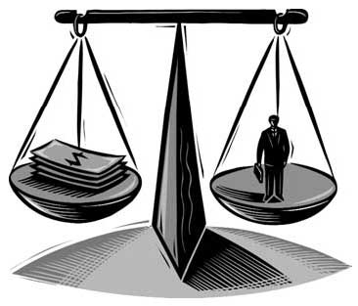
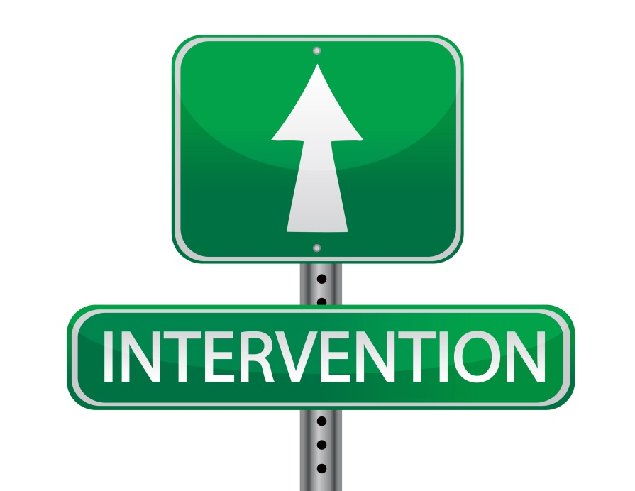
Why is it important?
Allocate Resources
Identify Treatment
Notes:
Allocate appropriate agency resources
Identify appropriate type/intensity of treatment

Slide 19
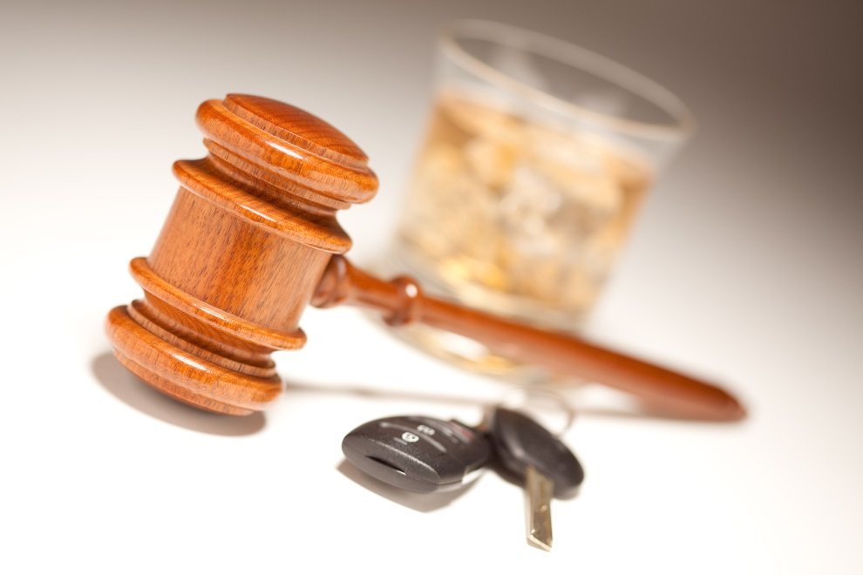
Major Risk Areas of Recidivism
Notes:
Prior DWI and non-DWI involvement in the justice system
Prior alcohol and other drugs (AOD) involvement
Mental health and mood adjustment problems
Resistance to and non-compliance with current and past involvement in the judicial system

Slide 20
Additional Areas for Consideration
Responsibility & Willingness
How defensive?
Notes:
Acceptance/Motivation: willingness to accept responsibility for DWI offense and to engage in intervention services
Defensiveness: need to protect self-image
BAC Level: may indicate behavioral/physical disruptions, greater awareness of AOD problems, and lack of judgment and responsibility
Aggravating Factors: auto crash, bodily injury or death, child/minor in vehicle, and prior felony DWI

Slide 21
Risk Assessment Instruments
ADS (Alcohol Dependence Scale)
ASUDS-R (Adult Substance Use and Driving Survey – Revised)
ASI (Alcohol Severity Index)
AUDIT (Alcohol Use Disorders Identification Test)
IDTS (Inventory Drug-Taking Situations)
DAST (Drug Abuse Screening Test)
LSI-R (Level of Service Inventory-Revised)
MAST (Michigan Alcoholism Screening Test)
SASSI (Substance Abuse Subtle Screening Inventory)
RIASI (Research Institute on Addiction Self Inventory)
CARS
Robertson, R.D., Wood, K. M., & Holmes, E. A. (2014). Impaired Driving Risk Assessment: A Primer for Practitioners. Ottawa, Ontario, Canada: Traffic Injury Research Foundation.
What risk assessment challenges do you face with DWI offenders?

Slide 22
Impaired Driving Assessment (IDA)

Slide 23
2 Components of the IDA
Self-Report (SR)
34 questions
Mental health and mood adjustment;
AOD involvement and disruption;
Social and legal non-conformity; and
Acknowledgment of problem behaviors and motivation to seek help for these problems.
Evaluator Report (ER)
11 questions
Past DWI/non-DWI involvement in judicial system;
Prior education and treatment episodes;
Past response to DWI education and/or treatment; and
Current supervision and services status.
Notes:
Self-report is essential with respect to:
Estimating the client’s “true” condition
Generating a baseline estimate of how the client perceives his/herself at the time of assessment
Measuring the client’s willingness to disclose
Other-report is essential with respect to:
Cross-validating the client’s self-report of information
Estimating the client’s level of defensiveness and openness to self-disclose

Slide 24
Utilization and Guidelines For IDA
What are we trying to accomplish?
Estimate the probability of negative outcomes and to reoffend
Estimate of supervision and service needs
What about the effects of services?
Initial estimate will not account for such effects
Significant level of false positives
Does the IDA only estimate risk?
Includes a resource for estimating service needs, responsivity to interventions, and traffic safety
Notes:
Effects of treatment……….

Slide 25
Utilization and Guidelines
Should assessment be an evolving process?
IDA is an initial screener, yet provides guidelines to proceed
Need more comprehensive assessment
How can we understand the impact to traffic safety?
Relevance of BAC levels in relation to risk
Responsibility to uphold traffic/public safety
Should the IDA be used as a sole basis for making decisions?
All sources of information are to be used―client/record
Final decisions are made by the evaluator and/or court
Notes:
Assessment is ongoing and dynamic. Data, information, and conclusions are relevant only for that point in time. Assessments become more dynamic when change modalities are introduced into the life of an individual. Although the content in assessment is important, it is relevant only within the context of the process of assessment.

Slide 26
More Information About the IDA
Currently available in paper/pen format
Individuals must undergo training
New project underway with NHTSA:
Online training course
Computerized version of the tool
Expand for widespread public use

Slide 27
Supervision-What works?
Guideline 2
Develop individualized case or supervision plans that outline supervision strategies and treatment services that will hold DWI offenders accountable and promote behavioral change.
Guideline 3
Implement a supervision process for DWI offenders that balances supervision strategies aimed at enforcing rules with those designed to assist offenders in changing behavior.
Notes:
From community supervision document. After you have completed your assessment of the individual, time to develop a plan based on risk and needs. It’s important to remember 2 things-
Important to follow the case, not the charge, hence individual case plan.
Don’t weigh drinking and driving behaviors in separation of other criminogenic factors

Slide 28
Supervision
Focus on the person, not the charge
Address criminogenic needs
The Big Four
The Next Four
Notes:
KRISTA Add big 4

Slide 29
The Big Four
Criminogenic Need | Response
History of anti-social behavior | Build non-criminal alternative behaviors to risky situations
Anti-social personality | Build problem solving, self management, anger management, and coping skills
Anti-social cognition | Reduce anti-social cognition, recognize risky thinking and feelings, adopt an alternative identity
Anti-social companions | Reduce association with criminals, enhance contact with pro-social
Source: Ed Latessa, Ph.D.
Notes:
The level of dependence for 1st offenders is the same as the level for multiple offenders-The difference is criminogenic risk factors.

Slide 30
The Next Four
Criminogenic Need | Response
Family and/or marital | Reduce conflict, build positive relationships and communication, enhance monitoring/supervision
Substance abuse | Reduce usage, reduce the supports for abuse behavior, enhance alternatives to abuse
School and/or work | Enhance performance rewards and satisfaction
Leisure and/or recreation | Enhance involvement and satisfaction in pro-social activities
Source: Ed Latessa, Ph.D.
Notes:
KRISTA

Slide 31
Probation terms should be…
Realistic
Relevant
Research based

Slide 32
Supervision-What works?
Guideline 4
Where possible, develop partnerships with programs, agencies, and organizations in the community that can enhance and support the supervision and treatment of DWI offenders.

Slide 33
Partnering and Collaboration
Notes:
Discuss a few available resources that can have impact in effective supervision of DUI offenders. What research says (both good and bad regarding these countermeasures

Slide 34
Ignition Interlock
Notes:
Brief description of how tool is used. INTERLOCK 101 An ignition interlock is a device that is installed on motor vehicles to prohibit individuals under the influence of alcohol from operating the vehicle. Individuals are required to blow into the device before starting the vehicle. If the device detects alcohol, it will prevent the vehicle from starting. In addition, at random times during the operation of the vehicle, the driver will be prompted to blow into the device to ensure they are not under the influence. When used as a condition of supervision in conjunction with a monitoring and reporting the ignition interlock system provides DWI offenders with an alternative to full license suspension.
Interlock is used in all 50 states

Slide 35
Ignition Interlock-What does the research say?
Reduces recidivism
: While installed
When used in conjunction with treatment
Notes:
Research studies have demonstrated a significant reduction – ranging from 50% to 90% – in recidivism while the devices are installed.
A number of these research studies have also shown significant increases in the rate of recidivism following the removal of the ignition interlock devices from the offender’s vehicle
Studies have found that drinking may continue but their drinking behavior (drinking and driving) may change
MI- encouraging continued appropriate behavior and compliance) is effective
Costs can be a few $$$ per day. A few important things to remember.
1). Long license suspensions can be a disincentive for individuals to use interlock. Generally speaking if driver has 2 year suspension, there is stronger likelihood that they will continue to drive without license
2). Important of information sharing with the provider. Is interlock information being sent to “black hole”?
Most effective if used in concert with treatment

Slide 36
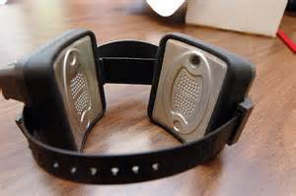
Transdermal Alcohol Devices
Notes:
Ankle bracelets that sample perspiration to detect alcohol. The results of the test is sent to authorities to show drinking events, tamper attempts.

Slide 37
Transdermal alcohol devices-What does research say?
Deters offenders from drinking
Accurate technology
Good at identifying noncompliance
Helps enforce abstinence
Notes:
Vendor describes SCRAM as the technology of last resort. Drinker who has demonstrated an inability to stop drinking.May be cost prohibitive. As it relates to driving, can take 45 minutes register alcohol use. If driving, that’s big issue. Time prevents me from addressing all technologies but other options. If you have the opportunity to go to conferences

Slide 38
Mobile Alcohol Monitoring Technology
Notes:
The portable alcohol monitoring device collects a breath sample to measure Breath Alcohol Concentration (BrAC), while simultaneously taking a photo of the individual to confirm their identity. The breathalyzer wirelessly submits the test results to a cloud-based Monitoring Web Portal where instant alerts can be set up to notify contacts if there are signs of a relapse.

Slide 39
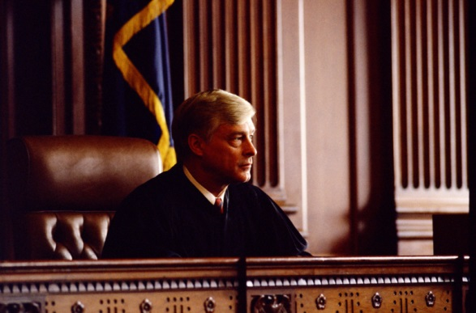
DWI Courts
Notes:
Over 600 DWI Courts nationwide

Slide 40
The Guiding Principles of DWI Courts
1: Determine the Population
2: Perform a Clinical Assessment 3: Develop the Treatment Plan 4: Supervise the Offender 5: Forge Agency, Organization, and Community Partnerships 6: Take a Judicial Leadership Role 7: Case Management Strategies 8: Address Transportation Issues 9: Evaluate the Program 10:Ensure a Sustainable Program
Notes:
Give a quick review. Give definition

Slide 41
DWI Courts-What does the research say?
Recidivism for repeat offenders that graduate from DWI courts tends to be low
Even if they don’t graduate, their recidivism is lower
On average DWI Courts reduce recidivism by 13% (Campbell Collaboration Assessment)
Cost savings compared to traditional court
Notes:
Studies reported out by NADCP Biggest challenge with any PSC is slippage from guiding principals.
Georgia
Repeat DWI offenders graduating from DWI Courts were up to 65% less likely to be re-arrested for a new DWI offense
All DWI Court participants had a recidivism rate of 15%, whether or not they graduated or were terminated, versus a recidivism rate of up to 35% for those not in DWI Court.
The three DWI Courts prevented between 47 and 112 more repeat DWI arrests.
Wisconsin
The DWI Court sample consisted of 3rd-time DWI offenders, 94 percent of whom had been diagnosed as alcohol dependent. Recidivism rates for any new offense were significantly lower for the DWI Court participants than for the comparison sample.
Michigan
Positive findings were also reported in a three-county evaluation of DWI Courts in Michigan. In nearly all of the comparisons, the trends favored better outcomes for the DWI Court participants. In one county, the participants were up to 19 times less likely to reoffend. The finding also noted that DWI Courts saved the criminal justice system time and money when compared to a traditional court.
On average DWI Courts reduce recidivism by 13%
Courts require a huge commitment and much heavy lifting but obvious benefits

Slide 42
Notes:
breakout who is in your community??

Slide 43
Treatment & Interventions for Impaired Drivers
Foundation:
Evidence-Based Principles for Effective Interventions

Slide 44
Treatment/Interventions for DUI Offenders
Motivational Interviewing or Motivational Enhancement
Cognitive Behavioral Therapy
Group Counseling/Therapy
Notes:
STUDIESHAVE SHOWN THAT IOP OFTEN HAS MORE QUALITY TREATMENT THAN RESIDENTIAL- STUDIES SHOW BETTY FORD NOT ALL THAT. Alcohol education =10% decrease in recividivism for properly assessed population. DUI offenders can be highly resistant to treatment, puts them way out of their comfort zone. DUI offenders often opt for prison rather than dealing with their demons. That’s why MI is so important in working with this population. Can keep reluctant client in treatment. When provided as the sole treatment, MI can lead to improvements in outcomes that compare with those seen in a 12-step Alcoholics Anonymous (AA) program. A recent study by Brown et al. (2010) suggests that MI may be more appropriate for impaired driving recidivists who were unmotivated, reluctant or resistant to participate in treatment, and who failed to acknowledge or recognize their problem(s) with alcohol.
CBT The objective of this approach is to identify thoughts, assumptions, beliefs, and behavours that are related to negative emotions and underlying dysfunctional problems (e.g., drinking problems) and to replace these with more realistic and functional ones. CBT is one of the most studied substance abuse treatment interventions, research investigating the effectiveness of CBT in reducing impaired driving recidivism is limited and only a small number of studies have specifically and rigorously tested the effectiveness of CBT, or variations of it, in reducing either alcohol misuse or impaired driving behavour among this offender population.
Brief interventions-series of questions designed to both screen for alcohol problems or alert those who may not fully recognize there’s a problem. Studies show they are effective and cost efficiant
nos MAT I WILL DISCUSS IN A FEW

Slide 45
Alcohol Treatment-What does the research say?
Evidence based
Matched to offender needs
Include an aftercare component
Effective treatment attends to multiple needs of the individual, not just his or her abuse
Relapse can be expected
Notes:
Reminder, treatment should not be used as a sanction…… IOP more effective for higher risk. Make sure IOP really is IOP- SAMHSA recommends X3 group sessions totaling 9 hours a week or 2 group sessions with 1 individual session.

Slide 46
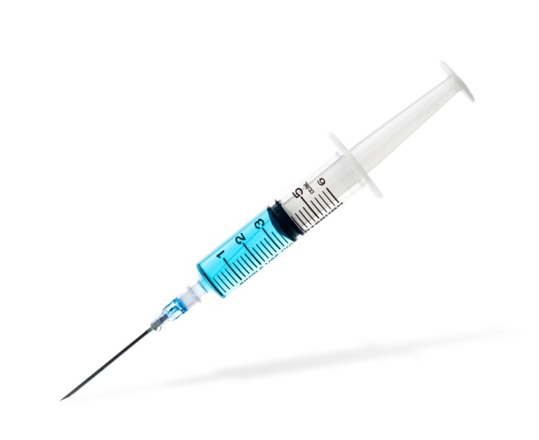
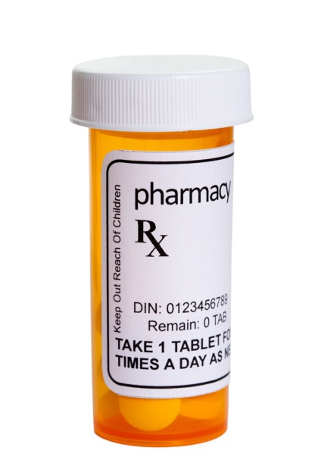
Medication Assisted Treatment (Pharmacological Interventions)
Naltrexone (Vivitrol-injectable version)
Reduces the pleasurable effects of alcohol
Camprol
Reduces physical and emotional discomfort in weeks after the individual stops drinking

Slide 47
MAT-What does research say?
Improve survival
Increase retention in treatment
Decrease criminal activities
Increase employment
Improve birth outcomes with perinatal addicts
Notes:
Historically it has been cost prohibitive. Check how your state is using ACA as it should be covered.

Slide 48
MAT-What does research say?
Doesn’t make you stop drinking
No clear evidence that MAT reduces cravings for alcohol
Should be used in conjunction with treatment
May be covered by insurance/Affordable Care Act
Notes:
Shouldn’t be confused with Anabuse

Slide 49
Costs to DWI Offenders
Court fines
Probation Service Fees
Attorney Fees
Interlock or other technologies
Treatment
Court program costs
Transportation costs after license suspension
$300-$500/month
Notes:
It is important to consider costs to individual and some of he unique challenges to compliance. Tendency to say if the defendant can afford beer they can afford other costs. However if everyone wants that beer money, what are we doing to the “well intentioned” individual who is trying to comply? Costs won’t go away but if they can be paced or staggered there is value in that.

Slide 50
What can the Probation Fellow do for You?
Train
Research
Collaboration
DWI courts

Slide 52
For More Information
American Probation and Parole Association- http://www.appa-net.org/eweb/
National Highway Traffic Safety Administration- http://www.nhtsa.gov/
Traffic Injury Research Foundation- http://www.tirf.ca/index.php
National Center for DWI Courts http://www.dwicourts.org/
Notes:
We hope you enjoyed the presentation on XXXXX. APPA would like to thank XXXX for taking time to speak to us today on this important topic.
Please feel free to use the contact information provided on your screen to reach out to the presenters of today’s webinar with any questions you may have about the information that was delivered.

Slide 53
Contact Information
Mark Stodola
Probationfellow@csg.org
602-402-0523
859-244-8057

Slide 54
American Probation and Parole Association
www.appa-net.org
Notes:
Finally, we hope that you will take some time to visit the APPA website to take some time to review the myriad resources we have available for community corrections professionals.
If you are already a member of APPA, thank you for your support!
If you are not a member of APPA, please visit our website today to join and begin taking advantage of all the resources we provide for our members, including our quarterly journal, Perspectives; discounts on registration for our Annual and Winter Training Institutes; discounts on online training courses; and much more.
This brings our webinar to a close. We appreciate your participation and hope to see you on future broadcasts.
Thank you and have a great day.

