Slide 1
PTSD and Substance Abuse in Veterans
Brian L. Meyer, Ph.D.
Interim Associate Chief,
Mental Health Clinical Services
McGuire VA Medical Center
Richmond, VA
March 24, 2015

Slide 2
Disclaimer
The views expressed in this presentation are solely those of the presenter and do not represent those of the Veterans Health Administration, the Department of Defense, or the United States government.

Slide 3
PTSD in Veterans

Slide 4
Multiple and Repeated Types of Trauma in the Military
Combat and war-zone trauma
Traumatic grief/loss
Military sexual trauma
Accidents

Slide 5
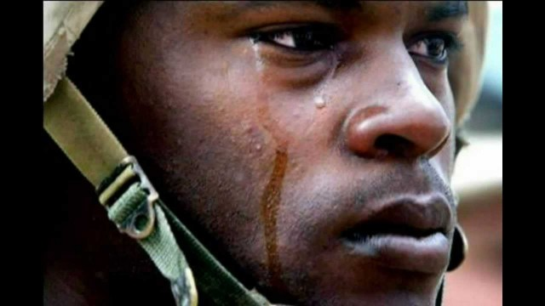
Trauma Exposure among OEF/OIF Veterans
50% had a friend seriously wounded or killed
45% saw dead or seriously wounded civilians
10% required hospitalization for injury
Tanielian & Jaycox,
RAND, 2008

Slide 6
Post-Traumatic Stress Disorder
PTSD is characterized by:
Exposure to a severe life-threatening event
Repetitive re-experiencing of the event
Avoidance of stimuli associated with trauma
Negative cognitions and mood
Increased arousal
(American Psychiatric Association, 2013)

Slide 7
Types of Military Stress Injuries
Combat/Operational Stress
Stress Adaptations
Stress Injuries
Positive Behaviors
Negative Behaviors
Traumatic Stress
Operational Fatigue
Grief
Moral Injury
A horrible or terrifying event
The wear and tear of deployment
The loss of friends and leaders
Actions that violate moral values
Notes:
This is the most important point to be made. Responses to stress can be either adaptations or injuries. Adaptations can be positive or negative, depending to a great deal on leadership, training, and unit cohesion. Injuries come in three main flavors, though there is much overlap in symptoms. Traumatic stress ius sue to terror or horror, operational fatigue is due to the accumulation of stresses over time (even small ones if they are relentless), and grief is due to the loss of important friends or leaders.

Slide 8
Post-Traumatic Responses Occur on a Continuum

Slide 9
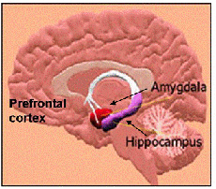
PTSD and the Brain
Amygdala – Emotional reactions, fight or flight alarm system
Hippocampus – Relay station for sorting memories
Prefrontal cortex – logic, reasoning, planning, impulse control, organizing
(Overactive)
(Underactive)
(Smaller volume)

Slide 10
Who Gets PTSD?
It depends on:
Severity
Duration
Proximity
PTSD is mitigated or worsened by:
Childhood experience
Personality characteristics
Family history
Social support

Slide 11
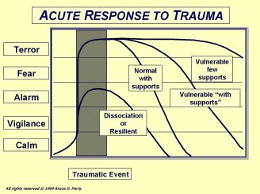

Slide 12
Military and Combat Reinforcement of PTSD Symptoms
These are all adaptive in a war zone and, in some cases, trained:
Reactivity to reminders
Avoidance of felt danger
Distrust of outsiders
Negative expectations of world
Anger
Aggressive behavior
Numbness
Hypervigilance
Startle responses
Risk-taking
Insomnia

Slide 13
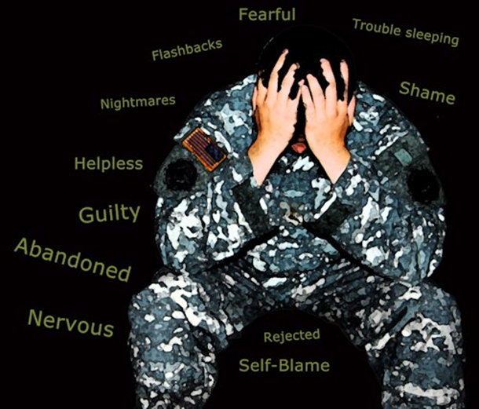
Variable Rates of PTSD in Different Conflicts
Vietnam veterans: lifetime prevalence 30.9 % for males and 26.9% for females (NVVRS, Kulka, Schlenger, et al., 1990)
This is equivalent to 479,000 veterans
First Gulf War veterans: 10.1% (Kang, Natelson et al., 2003)

Slide 14
Variable Rates of PTSD in Different Conflicts
OEF/OIF/OND veterans after 9/11/01: 13.8-21.8% (Seal, Metzler, et al., 2009; Tanielian & Jaycox, 2008)
28.4% of OEF/OIF/OND veterans treated in VHA have PTSD (VHA, 2012)
This is equivalent to 250,000 veterans
But 45% of veterans do not receive medical and mental health services from the VHA, so the number is much greater
Future estimates as high as 35% lifetime prevalence (Atkinson, Guetz, & Wein, 2009)
This is equivalent to 735,000 veterans

Slide 15
Increasing Numbers of Veterans
There are currently 22 million living veterans in the US (VA, 2012)
2.6 million veterans have been deployed to Iraq and/or Afghanistan since 9/11
Roughly one million more will be leaving military service by 2017 (VA, 2012)

Slide 16
Increasing PTSD among OEF/OIF/OND Veterans
2007 study measured PTSD and Depression among OEF-OIF veterans post-deployment and 6 months later (Milliken et al., 2007)
Six months later, half of those with PTSD symptoms improved
But there were twice as many new cases of PTSD
2009 San Francisco VAMC study shows that PTSD diagnoses among OEF-OIF veterans rose from 0.2% to 21.8% (Seal et al., 2009)
Diagnoses of PTSD in active servicemen and servicewomen increased 567% from 2003-2008 (Department of Defense, MSMR, November 2010)
PTSD emerges over time: more are coming

Slide 17
Increasing Numbers of Veterans with PTSD in the VHA

Slide 18
Increasing OEF/OIF/OND Veterans in VHA with PTSD Diagnosis 2002-2012

Slide 19
Combat Exposure and PTSD
Combat exposure increases PTSD (Kulka et al., 1990; Prigerson et al., 2002)
High war zone stress associated with greater levels of PTSD, both current and lifetime, than low and moderate war zone stress in Vietnam era veterans (Jordan et al., NVVRS, 1991)
Up to 58% of soldiers in heavy combat
50-75% of POWs and torture victims

Slide 20
The Problem of Repeated Deployments
This is now the longest war in American history, with the most repeated deployments
Repeated deployments wear down resiliency
36% of servicemen and women have been deployed twice or more (Department of Defense, 2008)
More than 400,000 servicemen and women have been deployed at least 3 times (Rosenbloom, 2013)
50,000 servicemen and women have had at least four deployments (Army Secretary John McHugh, testifying before Congress, 3/21/12)

Slide 21
Repeated Deployments Increase PTSD
Mental health problems increase with repeated deployments: 14.3% of those with one deployment, 21.8% of those with two, and 32.5% of those with three or four (Mental Health Advisory Team-VII, 2011)
Army soldiers deployed twice have 1.6 times greater chance of developing PTSD than those deployed once (Reger et al., 2009)
Active duty military with PTSD may be sent back into combat
Shorter dwell times increase risk of PTSD (MacGregor et al., 2012)

Slide 22
Frequency of Mental Disorders among OEF/OIF/OND Veterans Seen at VAMCs since 2002
804,704 (an increase of 121,183, or 17.7%, last year) Iraq and Afghanistan veterans seen at VAMCs between 1st Quarter FY 2002 and 2nd Quarter FY 2012
52.8 % diagnosed with mental health disorders
Of those diagnosed with MH disorders:
53.8% have PTSD
41.9% have Depression
36.9% have Anxiety Disorders
26.3-38.7% have Substance Use Disorders
VHA, 2012

Slide 23
Frequency of Mental Disorders among OEF/OIF/OND Veterans Seen at VAMCs since 2002
Disease Category (ICD code) | Total Number of OEF/OIF/OND Veterans* | Change since Q4FY11
PTSD (ICD-9CM 309.81) | 250,242 | 20.8%
Depressive Disorders (311) | 194,503 | 24.5%
Neurotic Disorders (300) | 171,530 | 27.3%
Tobacco Use Disorder (305.1) | 149,926 | 20.1%
Affective Psychoses (296) | 117,260 | 24.1%
Alcohol Abuse (305.0) | 58,316 | 23.4%
Alcohol Dependence Syndrome (303) | 55,897 | 26.6%
Non-Alcohol Abuse of Drugs (ICD 305.2-9) | 40,147 | 30.1%
Drug Dependence (304) | 30,198 | 31.4%
Specific Nonpsychotic Mental Disorder due to Organic Brain Damage (310) | 29,713 | 14.1%
N = 464,685
*Not including PTSD from VA’s Vet Centers or data from Veterans not enrolled for VA health care

Slide 24
Military Trauma in Women
2/3 of female OIF veterans report at least one combat experience (Milliken et al., 2007)
38% of OIF servicewomen are in firefights, and 7% report shooting at an enemy (Hoge et al., 2007)
OIF servicewomen handle human remains more often than servicemen: 38% vs. 29% (Hoge et al., 2007)
21% of female veterans of Iraq and Afghanistan have been diagnosed with PTSD (VA, 2010)

Slide 25
The Catalyzing Effects of Trauma
Health
Problems
Substance Abuse
Problems
Traumatic
Experiences
Mental Health
Problems
Criminal
Behavior
Relationship
Problems
Employment
Problems

Slide 26
Substance Use Disorders
in Veterans

Slide 27
Most Prevalent Disorders besides PTSD among Vietnam Veterans
Current Lifetime
Male Alcohol Abuse Alcohol Abuse Alcohol Dependence Alcohol Dependence
Generalized Anxiety D/O Generalized Anxiety D/O
Antisocial Personality D/O
Female Depression Generalized Anxiety D/O Generalized Anxiety D/O Depression
Alcohol Abuse Alcohol Abuse Alcohol Dependence Alcohol Dependence
Kulka et al., NVVRS, 1988

Slide 28
Substance Abuse Prevalence among Male Vietnam Veterans
Current Lifetime
Alcohol Abuse 11.2% 39.2%
or Dependence
Drug Use 1.8% 5.7%
or Dependence
Kulka et al., NVVRS, 1988

Slide 29
Combat Exposure Increases Substance Use
Alcohol abuse doubles after return from combat (Jacobson et al., 2008; Wilk et al., 2010)
Greater combat exposure associated with greater substance abuse (Prigerson et al., 2002; Reifman & Windle, 1996)
High war zone stress associated with greater alcohol and drug abuse, both current and lifetime, than low and moderate war zone stress in Vietnam era veterans (Jordan et al., NVVRS, 1991)

Slide 30
Frequency of Mental Disorders among OEF/OIF/OND Veterans Seen at VAMCs since 2002
804,704 (an increase of 121,183, or 17.7%, last year) Iraq and Afghanistan veterans seen at VAMCs between 1st Quarter FY 2002 and 2nd Quarter FY 2012
52.8 % diagnosed with mental health disorders
Of those diagnosed with MH disorders:
53.8% have PTSD
26.3-38.7% have Substance Use Disorders
VHA, 2012

Slide 31
Frequency of Mental Disorders among OEF/OIF/OND Veterans Seen at VAMCs since 2002
Disease Category (ICD code) | Total Number of OEF/OIF/OND Veterans* | Change since Q4FY11
PTSD (ICD-9CM 309.81) | 250,242 | 20.8%
Depressive Disorders (311) | 194,503 | 24.5%
Neurotic Disorders (300) | 171,530 | 27.3%
Tobacco Use Disorder (305.1) | 149,926 | 20.1%
Affective Psychoses (296) | 117,260 | 24.1%
Alcohol Abuse (305.0) | 58,316 | 23.4%
Alcohol Dependence Syndrome (303) | 55,897 | 26.6%
Non-Alcohol Abuse of Drugs (ICD 305.2-9) | 40,147 | 30.1%
Drug Dependence (304) | 30,198 | 31.4%
Specific Nonpsychotic Mental Disorder due to Organic Brain Damage (310) | 29,713 | 14.1%
N = 464,685
*Not including PTSD from VA’s Vet Centers or data from Veterans not enrolled for VA health care

Slide 32
Increase in Drinking for OEF-OIF Veterans
Hoge, 2004

Slide 33
Substance Abuse among OEF-OIF Veterans
12% of active duty personnel and 15% of reserve personnel meet criteria for Alcohol Abuse 6 months after returning home (Milliken et al., 2007)
17% of OEF-OIF veterans suffer from substance abuse problems (DOD, 2011)
Alcohol abuse among Army soldiers increased from 13% to 21% one year after return from Iraq and Afghanistan (Army Post-Deployment Reassessment Study, 2005)

Slide 34
Veterans Treated in SUD Specialty Care FY2005 - 2012
The number of unique veterans treated in an outpatient SUD specialty setting increased by 49.8% between FY05-12 and 2.6% since FY11 (VHA, 2012)

Slide 35
Percentage of OEF-OIF Veterans in VA with SUD Diagnoses

Slide 36
Most Common Substances Abused by Veterans
Alcohol
Marijuana
Crack cocaine
Heroin
Anxiolytics
Opiate painkillers

Slide 37
Some Reasons Why Substance Use is Common in the Armed Services
18-24 are the peak years of alcohol abuse
Masculine military culture
“Letting off steam” after hours
Soldiers used to be given free cigarettes
In Vietnam, soldiers were given 3% beer to drink
In Vietnam, opium and marijuana were common
Younger OEF-OIF veterans feel entitled to “party” and have fun

Slide 38
Co-Occurring PTSD and Substance Abuse in Veterans

Slide 39
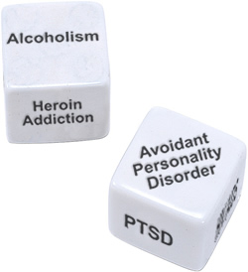
Co-occurrence of PTSD and Substance Abuse
Co-occurring disorders are the rule rather than the exception.
(SAMHSA, 2002)

Slide 40
Co-occurrence of PTSD and Substance Abuse

Slide 41
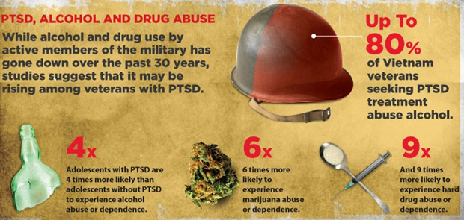
Co-occurrence of PTSD and Substance Abuse
PTSD and substance abuse co-occur at a high rate
20-40% of people with PTSD also have SUDs (SAMHSA, 2007)
40-60% of people with SUDs have PTSD
Among people with PTSD, 52% of men and 28% of women develop an Alcohol Use Disorder (Najavits, 2007)

Slide 42
Co-occurrence of PTSD and Substance Abuse
Substance use disorders are 3-4 times more prevalent in people with PTSD than those without PTSD (Khantzian & Albanese, 2008)
The presence of either disorder alone increases the risk for the development of the other
PTSD increases the risk of alcohol relapse (Heffner et al., 2011) and substance relapse (Norman et al., 2007)
The combination results in poorer treatment outcomes (Ouimette et al., 2003; Sonne et al., 2003)

Slide 43
Rates of SUDs in Vietnam Veterans with PTSD
Current Lifetime
Alcohol Abuse/
Dependence 22% 75%
Drug Abuse/
Dependence 6% 23%
Kulka et al., NVVRS, 1988

Slide 44
Veterans in VHA Care with PTSD Diagnosis and SUD FY02-12
The number of users with SUD-PTSD more than tripled between 2002 and 2012
VHA, 2012

Slide 45
Veterans with PTSD Receiving Specialty SUD Treatment FY02-12
The number of users with SUD-PTSD nearly tripled between 2002 and 2012
Fewer than half of veterans with PTSD-SUD diagnoses received treatment in any year
VHA, 2012

Slide 46
Trends in SUD-PTSD as % of all SUD

Slide 47
PTSD and SUD in OIF/OEF Veterans
Veterans with PTSD also:
Binge on alcohol – 50% (2 X community rate)
Smoke tobacco – 50% (2.5 X community rate)
Abuse opiates – 9% (3 X community rate)
Abuse other drugs – inhalants, sedatives, and marijuana
Rand, 2008

Slide 48
Pathways Between Trauma-related Disorders and Substance Use
PTSD
TRAUMA
SUD
Hien, 2004
Notes:
3

Slide 49
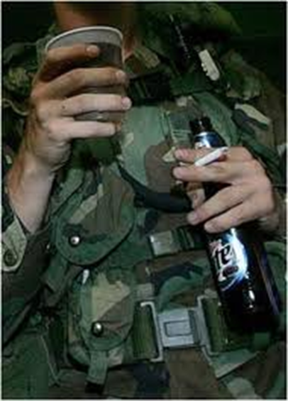
Co-Occurring PTSD and SUDs Make Each Other Worse
Substance abuse exacerbates PTSD symptoms, including sleep disturbance, nightmares, rage, depression, avoidance, numbing of feelings, social isolation, irritability, hypervigilance, paranoia, and suicidal ideation
People who drink or use drugs are at risk for being retraumatized through accidents, injuries, and sexual trauma

Slide 50
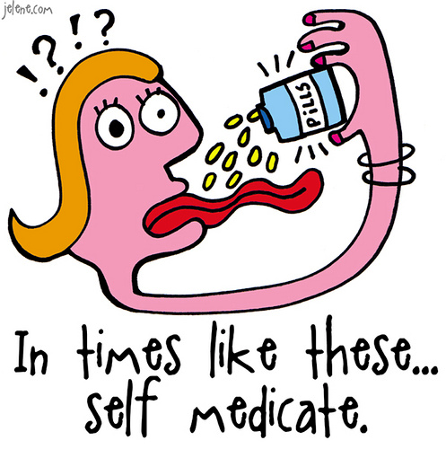
The Truth about Self-Medication
Only about 1/3 of people start abusing substances after their traumatic experience
About 1/3 experience trauma and start abusing substances simultaneously
About 1/3 abuse substances before they experience trauma

Slide 51
Many Reasons Why People with PTSD Use Substances
To numb their painful feelings (self-medication).
To try to relax.
To forget the past.
To go to sleep.
To prevent nightmares.
To cope with physical pain.
To stop dissociation and flashbacks.
To feel some pleasure in life.
To let out their anger.

Slide 52
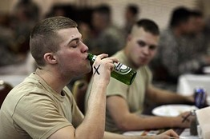
Many Reasons Why People with PTSD Use Substances
Physical pain.
Peer pressure.
To socialize with other people and feel accepted.
Family members drank or used drugs when they were growing up.
It was common in the military.
Boredom.
To get through the day.
To show people how bad they feel.
To commit “slow suicide.”

Slide 53
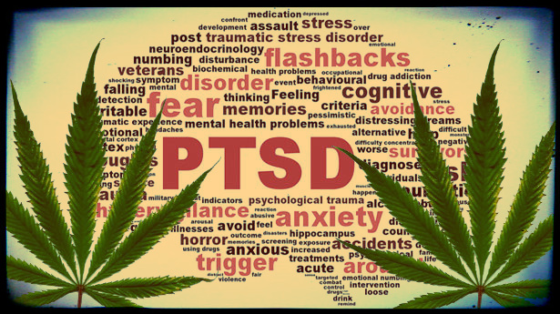
One More Reason: Confusion about Marijuana
Four states have legalized marijuana (Washington, Colorado, Alaska, and Oregon)
23 states and Washington, DC, have legalized medical marijuana
Many veterans claim marijuana helps their PTSD
There are no studies yet about whether marijuana decreases PTSD symptoms

Slide 54
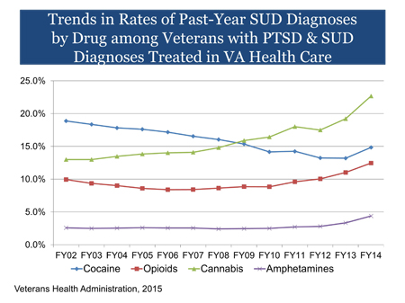

Slide 55
PTSD/SUD Patients Have Significantly More Problems
Other Axis I disorders
Increased psychiatric symptoms
Increased inpatient admissions
Interpersonal problems
Medical problems
HIV risk
Decreased motivation for treatment
Decreased compliance with aftercare
Maltreatment of children
Custody battles
Homelessness

Slide 56
The Rationale for Integrated Treatment

Slide 57
Why Should We Treat Co-Occurring Disorders Integratively?
PTSD does not go away with abstinence; in fact, it may get worse, at least initially
Improvement in PTSD symptoms does not bring about abstinence from substance use
Even if substance abuse began as self-medication, it takes on a life of its own
Separate treatment is usually uncoordinated and at worst countertherapeutic
Integrated treatment leads to better outcomes

Slide 58
The Importance of Integrated Treatment for PTSD and SUDs
Treating one disorder without treating the other is ineffective
Sequential treatment (usually SUD first) is ineffective
Fully integrated treatment is optimal
Simultaneous treatment is next best

Slide 59
The Importance of Integrated Treatment for PTSD and SUDs
Recent evidence on integrated and simultaneous treatment (Hien et al., 2010) suggests:
- If PTSD symptoms decline, so do SUDs
- If SUDs decline, PTSD symptoms do not
Therefore, treating substance abuse without treating PTSD will fail
This includes ASAP programs

Slide 60
Barriers to Integrated Treatment
Most insurance does not pay for substance abuse treatment
Separate payment streams
Separate treatment systems
Professional training biases
Lack of dually trained clinicians

Slide 61
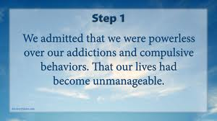
PTSD and Substance Abuse Treatment
PTSD symptoms may worsen in the early stages of abstinence
Some aspects of 12-Step groups are difficult for some trauma patients
Powerlessness
Higher Power
Issues of forgiveness

Slide 62
Integrated Treatment of PTSD and Substance Abuse

Slide 63
Trauma-Informed ≠ Evidence-Based Treatment
Trauma-informed treatment means that trauma is taken into account when treating substance abuse
Beyond Trauma: A Healing Journey for Women by Stephanie Covington
Evidence-based means that research has shown treatment to be effective
Seeking Safety by Lisa Najavits
Evidence-based is better

Slide 64
Phases of Integrated Treatment
After Herman, 1992
Phase I: Safety and Stabilization
Phase II: Remembrance and Mourning
Phase III: Reconnection

Slide 65
Stage I: Safety and Stabilization
Alliance building
Psychoeducation about multiple traumas
Safety
Stabilization
Skills-building
Affective regulation
Cognitive
Interpersonal
Self-care

Slide 66
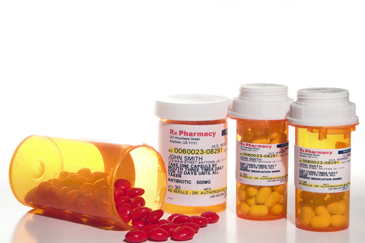
Medication Treatment of Substance Use Disorders
Alcohol:
Antabuse (Disulfiram)
Naltrexone
Acamprosate
Opiates:
Methadone
Buprenorphine

Slide 67
Psychological Treatment of Substance Use Disorders
Evidence-Based Treatments:
Motivational Interviewing
Motivational Enhancement Therapy
Cognitive-Behavioral Therapy (CBT)
Contingency Management
Twelve-step Facilitation Therapy
Behavioral Couples Therapy

Slide 68
Treatment of PTSD: Medication
Medication for trauma symptom management and co-morbid disorders
Antidepressants
Mood stabilizers
Atypical antipsychotics
Anticonvulsants
Anxiolytics
Sleep aids
There is no medication that specifically treats PTSD; only Prozac, Paxil, and Prazosin have been approved

Slide 69
Psychological Treatment of PTSD and SUDs
Evidence-Based Psychotherapies for Integrated Phase I Treatment:
Seeking Safety
Dialectical Behavior Therapy (DBT)
Therapies for specific problems
Imagery Rehearsal Therapy
Cognitive-Behavioral Therapy
EMDR resource building, safe place, etc.

Slide 70
Seeking Safety
25 lessons on topics that overlap between PTSD and Substance Abuse
Safety Skills
Grounding
Anger
Boundaries
Self-care
Honesty
Compassion

Slide 71
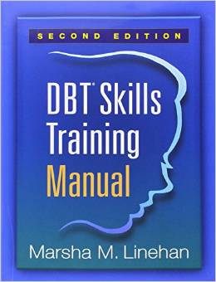
DBT Skills Training
Four topics with multiple lessons
Mindfulness
Interpersonal Effectiveness
Distress Tolerance
Affect Regulation
New manual provides suggested menus of different specific skills and exercises with different populations

Slide 72
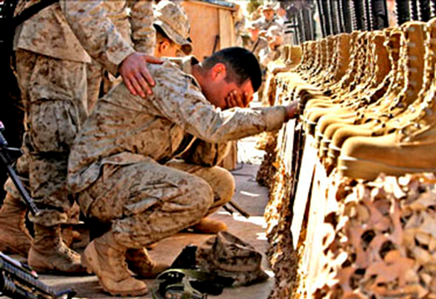
Stage II: Remembrance and Mourning
Exposure and desensitization
Processing
Grieving
Constructing a narrative
Integration of the trauma

Slide 73
Treatment of PTSD in Phase II
Evidence-Based Psychotherapies for Phase II Trauma Treatment:
Cognitive Processing Therapy (CPT)
Prolonged Exposure (PE)
Eye Movement Desensitization and Reprocessing (EMDR)
EMDR has a specific protocol to deal with urges to use substances

Slide 74
Stage III: Reconnection
Gradually decrease isolation
Re-establishing estranged relationships
Developing trusting relationships
Developing intimacy
Developing sexual intimacy
Parenting
Community-based activities
Spirituality

Slide 75
Stage III: Reconnection
There are no Evidence-Based Psychotherapies for Phase III trauma treatment
but couples and/or family therapy may be helpful
Cognitive-Behavioral Conjoint Therapy for PTSD shows promise (Monson and Fredman, 2012)

Slide 76
Integrated Treatment for PTSD and Substance Abuse
Seeking Safety is the only empirically-supported integrated treatment for both PTSD and Substance Abuse
But it is only a Phase I treatment for Safety and Stabilization

Slide 77
Recent Research on Treatment for PTSD and SUDs
Two recent studies of treatment of PTSD and SUDs using Prolonged Exposure and simultaneous SUD treatment show mixed results
Exposure therapy does not increase substance use
One study found that integrated exposure therapy plus SUD treatment improves trauma symptoms but not substance abuse, depression or anxiety compared to TAU (Mills et al., 2012)
The other found that Prolonged Exposure plus Naltrexone does not improve trauma symptoms more than treatment as usual (Foa et al., 2013)

Slide 78
Promising Treatments: Mindfulness Meditation
Mindfulness Meditation
DBT
Mindfulness-Based Stress Reduction
MBSR reduces PTSD symptoms in Veterans (Kearney et al., 2012; Kluepfel et al., 2013)
Mindfulness-Based Relapse Prevention
Acceptance and Commitment Therapy

Slide 79
Promising Treatments: STAIR Narrative Therapy
Skills Training in Affective and Interpersonal Regulation (STAIR) Narrative Therapy (Cloitre et al., 2006)
Uses coping skills from Stress Inoculation Training and Dialectical Behavior Therapy
8-10 sessions of skills building and 8 sessions of narrative therapy
This is the only Phase I and Phase II treatment for trauma and complex trauma

Slide 80
Resources

Slide 81
What It Is Like to Have PTSD
What It Is Like to Go to War by Karl Marlantes
On Killing: The Psychological Cost of Learning to Kill in War and Society (2009), Dave Grossman
Achilles in Vietnam: Combat Trauma and the Undoing of Character (1995), Jonathan Shay
Military culture course: www.ptsd.va.gov/professional/ptsd101/course-modules/military_culture.asp

Slide 82
Resources for PTSD
National Center for PTSD: www.ptsd.va.gov
International Society for Traumatic Stress Studies: www.istss.org
International Society for the Study of Trauma and Dissociation: www.isst-d.org
PTSD 101 courses: www.ptsd.va.gov/professional/ptsd101/course-modules.asp
http://mghcme.org/courses/course-detail/from_the_war_zone_to_the_home_front_supporting_the_ mental_health_of_veteran

Slide 83
Veteran Resources for PTSD
Once a Warrior--Always a Warrior: Navigating the Transition from Combat to Home--Including Combat Stress, PTSD, and mTBI by Charles Hoge
The PTSD Workbook: Simple, Effective Techniques for Overcoming Traumatic Stress Symptoms by Mary Beth Williams and Soili Poijula
After the War Zone: A Practical Guide for Returning Troops and Their Families by Matthew Friedman and Laurie Slone
Free podcast available at https://itunes.apple.com/eg/podcast/returning-from-the-war-zone/id657517343

Slide 84
Veteran Resources for PTSD
Adjustment after deployment
www.afterdeployment.org
http://maketheconnection.net
PTSD treatment can help: www.ptsd.va.gov/apps/AboutFace

Slide 85
Family Resources
When Someone You Love Suffers from Posttraumatic Stress: What to Expect and What You Can Do by Claudia Zayfert and Jason Deviva
Finding My Way: A Teen’s Guide to Living with a Parent Who Has Experienced Trauma (2005), Michelle Sherman and DeAnne Sherma
http://www.ptsd.va.gov/public/pages/fslist-family-relationships.asp
Helping family members get veterans into treatment: Coaching Into Care www.mirecc.va.gov/coaching/index.asp

Slide 86
PTSD and SUDs
PTSD 101 course about treating PTSD and SUDs: www.ptsd.va.gov/professional/ptsd101/course-modules/SUD.asp
Practice recommendations for treating co-occurring PTSD and SUDs: www.ptsd.va.gov/professional/pages/handouts-pdf/SUD_PTSD_Practice_Recommend.pdf

Slide 87
Seeking Safety
Seeking Safety (1998), Lisa Najavits
8 Keys to Trauma and Addiction Recovery (2015), Lisa Najavits
http://www.treatment-innovations.org/seeking-safety.html

Slide 88
Dialectical Behavior Therapy
Cognitive-Behavioral Treatment of Borderline Personality Disorder (1993), Marsha Linehan
DBT Skills Training Manual, 2nd edition (2014), Marsha Linehan
DBT Skills Training Handouts and Worksheets, 2nd edition (2014), Marsha Linehan
http://www.behavioraltech.com
http://www.linehaninstitute.org/

Slide 89
Prolonged Exposure
Prolonged Exposure Therapy for PTSD: Emotional Processing of Traumatic Experiences Therapist Guide (2007), Edna Foa, Elizabeth Hembree and Barbara Olaslov Rothbaum
Reclaiming Your Life from a Traumatic Experience: A Prolonged Exposure Treatment Program Workbook (2007), Barbara Rothbaum, Edna Foa and Elizabeth Hembree

Slide 90
Cognitive Processing Therapy
Cognitive Processing Therapy for Rape Victims: A Treatment Manual (1993), Patricia Resick and Monica Schnicke

Slide 91
EMDR
Eye Movement Desensitization and Reprocessing (EMDR): Basic Principles, Protocols, and Procedures, 2nd Ed. (2001), Francine Shapiro
Getting Past Your Past: Take Control of Your Life with Self-Help Techniques from EMDR Therapy (2013), Francine Shapiro
www.emdr.com
www.emdria.org
www.emdrhap.org

Slide 92
Resources
Trauma and Substance Abuse (2nd ed.) by Page Ouimette and Jennifer Read
Treating Survivors of Childhood Abuse: Psychotherapy for the Interrupted Life by Marylene Cloitre, Lisa Cohen, and Karestan Koenen
Concurrent Treatment of PTSD and Substance Use Disorders Using Prolonged Exposure (COPE) Therapist Guide by Sudie Back, Edna Foa, Therese Killeen, Katherine Mills, Maree Teesson, Bonnie Cotton, Kathleen Carroll, and Kathleen Brady

Slide 93
Internet Resources
PTSD 101 course about treating PTSD and SUDs: http://www.ptsd.va.gov/professional/ ptsd101/course-modules/SUD.asp
Practice recommendations for treating co-occurring PTSD and SUDs: http://www.ptsd. va.gov/professional/pages/handouts-pdf/SUD_PTSD_Practice_Recommend.pdf

Slide 94
Internet Resources
Helping family members get veterans into treatment: Coaching Into Care
http://www.mirecc.va.gov/coaching/index.asp
Adjustment after deployment
http://www.afterdeployment.org/
http://maketheconnection.net/
PTSD treatment can help
http://www.ptsd.va.gov/apps/AboutFace/

Slide 95
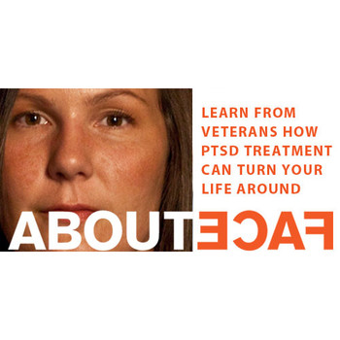
Online and Telephone Resources

Slide 96
Online Resources
Self-assessment Mental Health screening
http://www.militarymentalhealth.org/
Computer-based Problem-Solving Therapy
http://startmovingforward.t2.health.mil/
Wellness resources
http://afterdeployment.t2.health.mil/

Slide 97
Self-Help Mobile Applications
http://www.t2health.org/mobile-apps
PTSD Coach
T2 MoodTracker
Breathe 2 Relax
Tactical Breather

Slide 98
Self-Help Mobile Applications
http://www.t2health.org/mobile-apps
Mindfulness Coach
Parenting2Go
LifeArmor (includes family section)

Slide 99
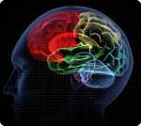
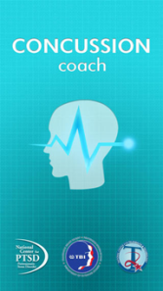
Self-Help Mobile Applications
http://www.t2health.org/mobile-apps
mTBI Pocket Guide
Concussion Coach
Biofeedback

Slide 100
Self-Help Mobile Applications
Positive Activity Jackpot
http://www.militarymentalhealth.org/ articles/media/
Virtual Hope Box
Provider Resilience
More to come!

Slide 101
Mobile Applications That Assist Psychotherapy
PE Coach
CPT Coach
CBT-I Coach
ACT Coach

Slide 103
Contact:
Brian L. Meyer, Ph.D.
Brian.Meyer@va.gov

