Slide 1
Key Moments in NADCP History
Adult Drug Court
Best Practice Standards
Douglas B. Marlowe, J.D., Ph.D.
National Association of
Drug Court Professionals
Aspirational
Enforceable

Slide 2
Adult Drug Courts
No. Drug Courts
Arrests Reduced
Institution(s)
Citation
Mitchell et al. (2012)
U.S.F., G.M.U.
& Penn. State
Rempel et al. (2012)
92
12%
Urban Institute,
CCI & RTI
23
13%
Wilson et al. (2006)
Campbell
Collaborative
Latimer et al. (2006)
55
14%
Canada Dept. of
Justice
66
9%
Shaffer (2010)
University of
Nevada
9%
Lowenkamp et al.
(2005)
76
University of
Cincinnati
Washington State Inst.
for Public Policy
8%
Aos et al. (2006)
22
8%
57

Slide 3
Substance Use
Saliva tests at 18 months
Rossman et al., 2011

Slide 4
Key Moments in NADCP History
Incarceration Rates
50%
Incarceration rate
Alternative
base rate
Drug Court:
jail
Drug Court:
prison
Sevigney et al., 2013
*p < .05

Slide 5
Key Moments in NADCP History
Incarceration Rates
50%
42%*
38%*
Incarceration rate
Alternative
base rate
Drug Court:
jail
Drug Court:
prison
Sevigney et al., 2013
*p < .05

Slide 6
Key Moments in NADCP History
Target Population
Eligibility & exclusion criteria are based on empirical evidence
Assessment process is evidence-based

Slide 7
Key Moments in NADCP History
Target Population
HIGH RISK
Twice the reduction
in re-arrests
10%*
8%
5%
}
Lowenkamp et al., 2005

Slide 8
Key Moments in NADCP History
Target Population
Twice the reduction
in re-arrests
HIGH RISK
}
Carey et al. (2012)

Slide 9
Key Moments in NADCP History
Target Population
Nearly twice the cost benefit
HIGH NEED
}
Carey et al. (2012)

Slide 10
Key Moments in NADCP History
Target Population
Eligibility & exclusion criteria are based on empirical evidence
Assessment process is evidence-based
Objective eligibility criteria
High-risk & high-need participants
Validated eligibility assessments
Criminal history disqualifications
“Barring legal prohibitions . . .”
Clinical disqualifications
“If adequate treatment is available . . . “

Slide 11
Key Moments in NADCP History
Hx Disadvantaged Groups
Equivalent opportunities to participate and succeed in Drug Court

Slide 12
Minority Representation
Minority Representation
Race or Ethnicity | Average % (SD) | Range
Caucasian | 62% (14%) | 1% - 98%
African-American | 21% (28%) | 1% - 95%
Hispanic / Latino(a) | 10% (17%) | 0% - 95%
Native American | 4% | < 1% - 22%

Slide 13
Minority Representation
Minority Representation
44%
39%
28%
29%
21%
20%
14%
15%
16%
10%
13%
?
Notes:
Note the 70% level….

Slide 14
Minority Representation
Minority Representation
44%
39%
28%
29%
21%
20%
14%
15%
16%
10%
13%
?
Notes:
Note the 70% level….

Slide 15
Risk for Treatment Failure
Poorer CJ Outcomes
Male gender
Current age < 25 years
Delinquency or substance abuse onset < 16 years
Drug of choice (e.g., crack cocaine)
Lower income or chronically unemployed
Prior rehabilitation failures
Antisocial Personality Disorder
Familial history of crime or addiction
Criminal or substance abuse associations

Slide 16
Risk for Treatment Failure
Poorer CJ Outcomes
Male gender
Current age < 25 years
Delinquency or substance abuse onset < 16 years
Drug of choice (especially crack cocaine)
Lower income or chronic unemployment
Prior rehabilitation failures
Antisocial Personality Disorder
Familial history of crime or addiction
Criminal or substance abuse associations

Slide 17
Culturally Proficient Treatment
African American Males 18 to 25
Successful Graduation Rates
*
*
41.5%
*
21.9%
7.1%
n = 65
n =114
n = 56
Vito & Tewksbury, 1998
Notes:
17

Slide 18
Key Moments in NADCP History
Hx Disadvantaged Groups
Equivalent opportunities to participate and succeed in Drug Court
Equivalent access (intent & impact)
Equivalent retention
Equivalent treatment
Equivalent incentives & sanctions
Equivalent legal dispositions
Team training (remedial measures)

Slide 19
Key Moments in NADCP History
Roles of the Judge
Contemporary knowledge; active engagement; professional demeanor; leader among equals

Slide 20
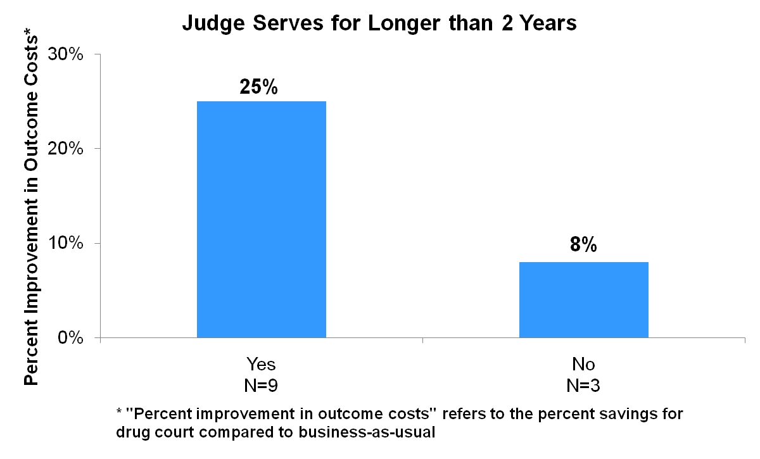
Judicial Term
Three times greater cost benefits
}
Carey et al., 2012

Slide 21
Key Moments in NADCP History
Consistent Docket
Best
outcomes
58%
51%
*
Re-arrest rate
39%
# judges presiding
Goldkamp et al., 2002

Slide 22
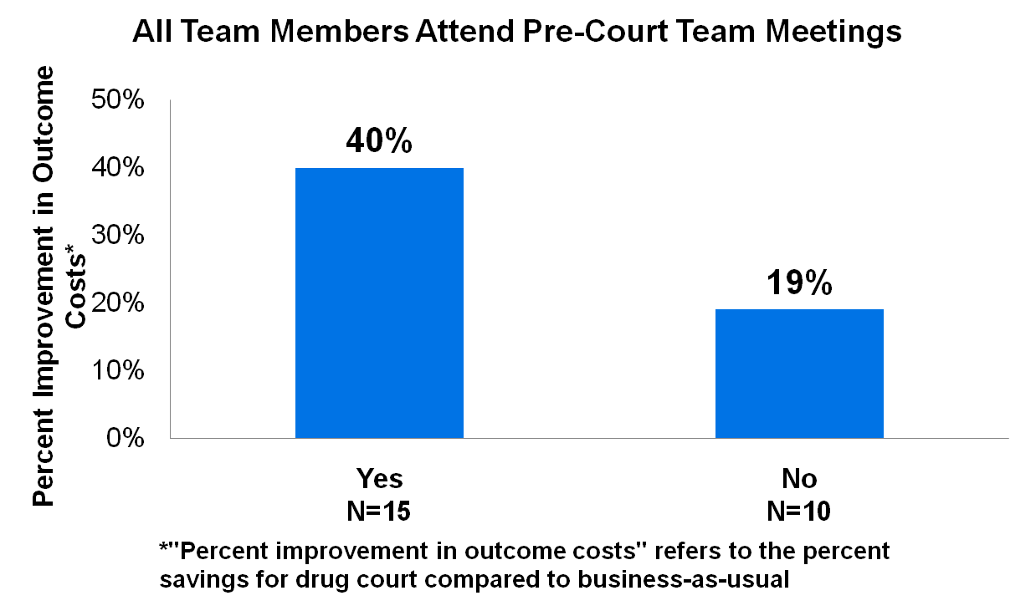
Key Moments in NADCP History
Pre-Court Staffings
Structre
Twice the cost benefits
Twice the cost benefit
}
}
Carey et al. (2012)

Slide 23
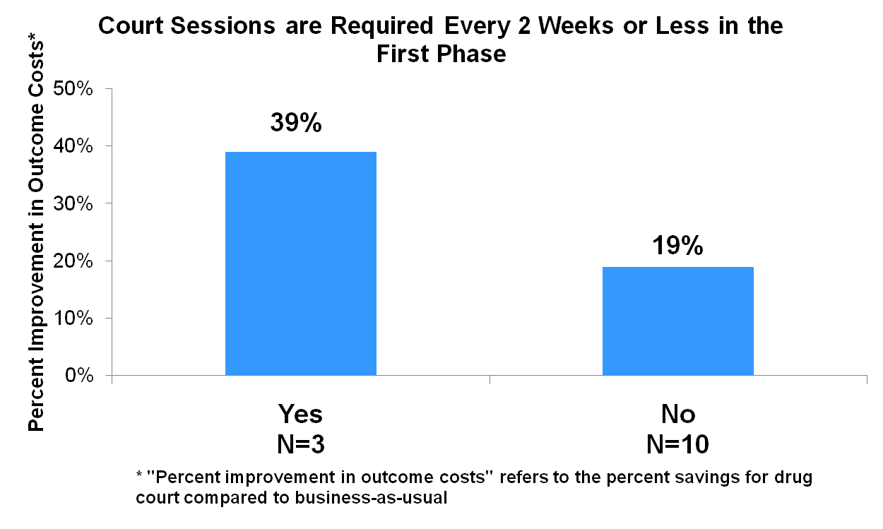
Key Moments in NADCP History
Status Hearings
Structre
Twice the cost benefit
}
Carey et al. (2012)

Slide 24
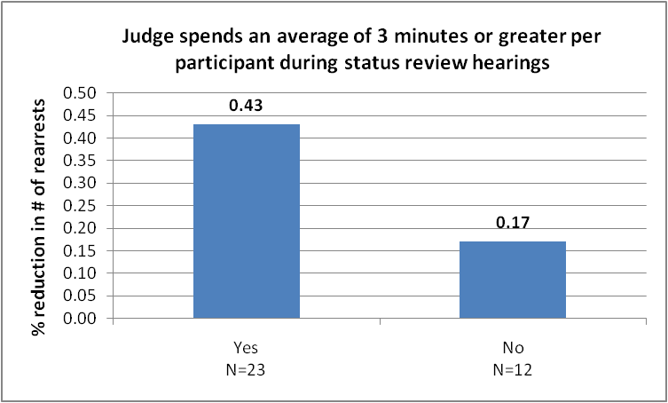
Key Moments in NADCP History
Length of Interactions
Structre
Two and a half times the reduction in crime
Twice the cost benefit
43%
}
}
17%
Carey et al. (2012)

Slide 25
Key Moments in NADCP History
Positive Judicial Qualities
4.2 *
3.6 *
# Crimes averted
0.7
* p < .05
Rossman et al., 2011; Zweig et al., 2012

Slide 26
Key Moments in NADCP History
Roles of the Judge
Contemporary knowledge; active engagement; professional demeanor; leader among equals
Professional training
Length of term
Consistent docket
Pre-court staff meetings
Frequency of status hearings
Length of court interactions
Judicial demeanor
Judicial decision-making

Slide 27
Key Moments in NADCP History
Incentives & Sanctions
Predictable, consistent, fair, and evidence-based

Slide 28
Key Moments in NADCP History
Predictable Responses
Predictable but flexible
3.9 *
4.3 *
# Crimes averted
1.8
* p < .05
Rossman et al., 2011; Zweig et al., 2012

Slide 29
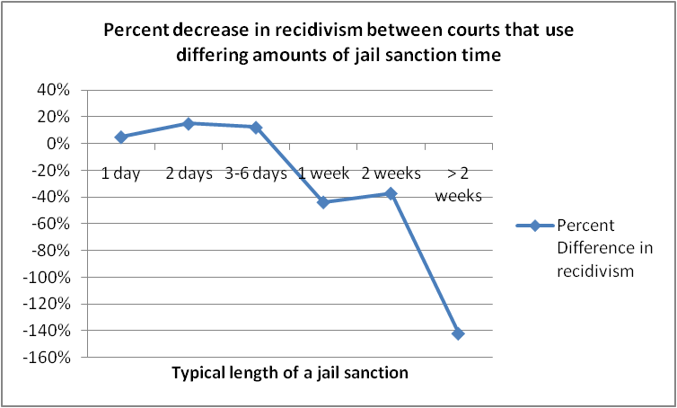
Jail Sanctions
Carey et al., 2012

Slide 30
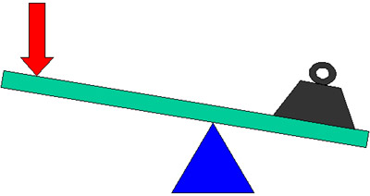
Key Moments in NADCP History
Legal Leverage
4.1 *
# Crimes averted
2.0
1.4
* p < .05
Rossman et al., 2011; Zweig et al., 2012

Slide 31
Key Moments in NADCP History
Incentives & Sanctions
Predictable, consistent, fair, and evidence-based
Advance notice
Opportunity to be heard
Equivalent consequences
Professional demeanor
Progressive sanctions
Licit substances
Therapeutic adjustments
Incentivizing productivity

Slide 32
Key Moments in NADCP History
Incentives & Sanctions (cont.)
Predictable, consistent, fair, and evidence-based
. . .
Phase promotion
Jail sanctions
Termination
Consequences of graduation and termination (leverage)

Slide 33
Key Moments in NADCP History
Treatment Services
4.3 †
3.0
# Crimes averted
1.2
Frequency of sessions
† p < .10
Rossman et al., 2011; Zweig et al., 2012

Slide 34
Key Moments in NADCP History
Substance Abuse Treatment
Based on treatment needs and evidence-based
Continuum of care
“if adequate care is unavailable . . .”
In-custody treatment
Team representation
Treatment dosage and duration
Treatment modalities
Evidence-based treatments
Medications
Medically necessary or medically
indicated, and reasonably available

Slide 35
Key Moments in NADCP History
Substance Abuse Tx (cont.)
Based on treatment needs and evidence-based
. . .
Provider training and credentials
Peer support groups
Continuing care

Slide 36
Key Moments in NADCP History
Complementary Services
Responsivity needs, criminogenic needs, or maintenance needs
Scope of needs in population
Timing and sequence of services
Clinical case management
Mental health treatment (integrated + medications)
Trauma-informed
Criminal thinking
Family & interpersonal counseling
Vocational or educational counseling
Medical or dental treatment
Health-risk and overdose education

Slide 37
Key Moments in NADCP History
Drug & Alcohol Testing
Valid, timely and comprehensive

Slide 38
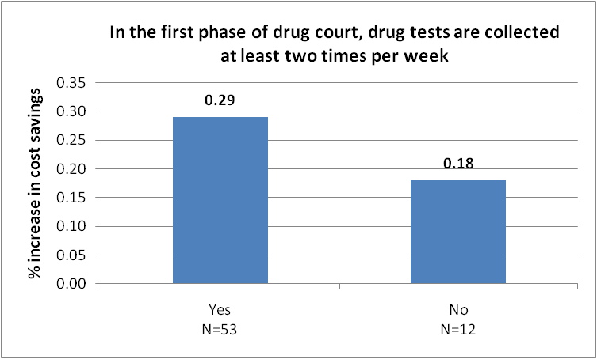
Drug Courts That Performed Drug Testing Two or More Times Per Week Had Greater Cost Savings

Slide 39
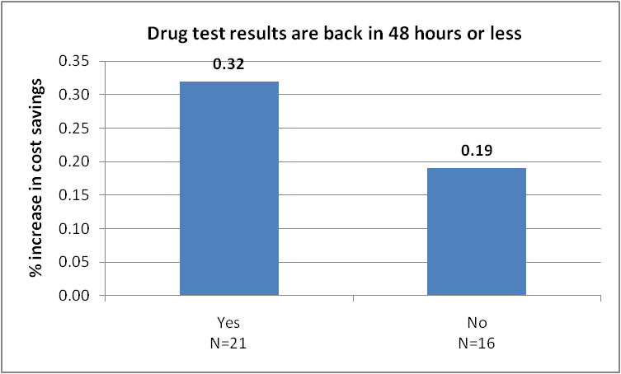
Drug Courts That Received Drug Test Results Within 48 Hours Had Greater Cost Savings
Note 1: Difference is significant at p<.05

Slide 40
Key Moments in NADCP History
Drug & Alcohol Testing
Valid, timely and comprehensive
Frequent testing
Random testing
Duration of testing
Comprehensive panels
Witnessed collection
Valid specimens
Valid & reliable procedures
Rapid results
Participant contract

Slide 41
Key Moments in NADCP History
Monitoring & Evaluation
Routine monitoring of best practices and valid evaluations of effectiveness
Adherence to best practices (annually)
In-program outcomes (NRAC)
Criminal recidivism (3 yrs.)
Independent evaluations (5 yrs.)
Electronic database
Timely & reliable data entry
Intent-to-treat analyses
Valid comparison groups
Equivalent time at risk

